Slide 1

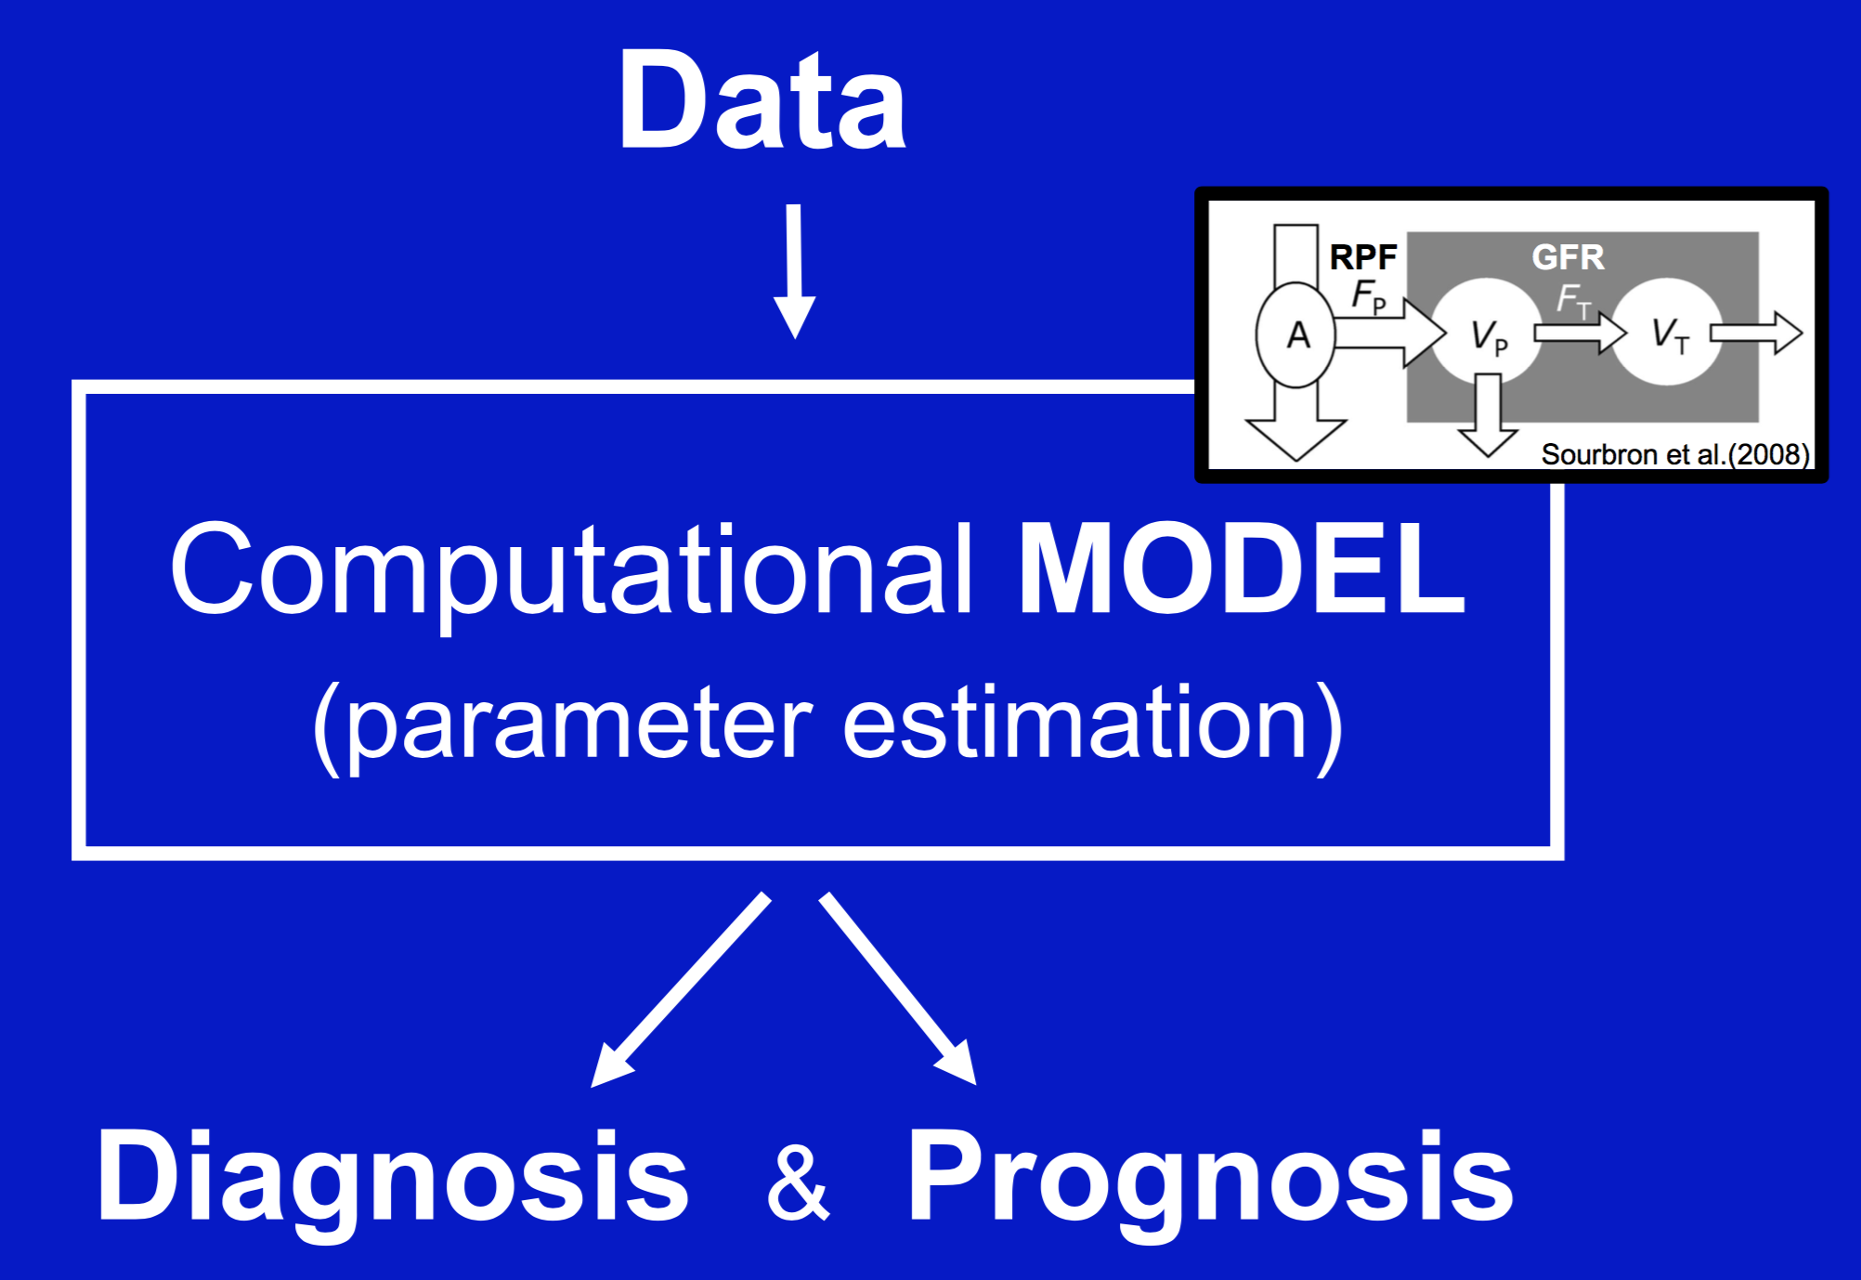
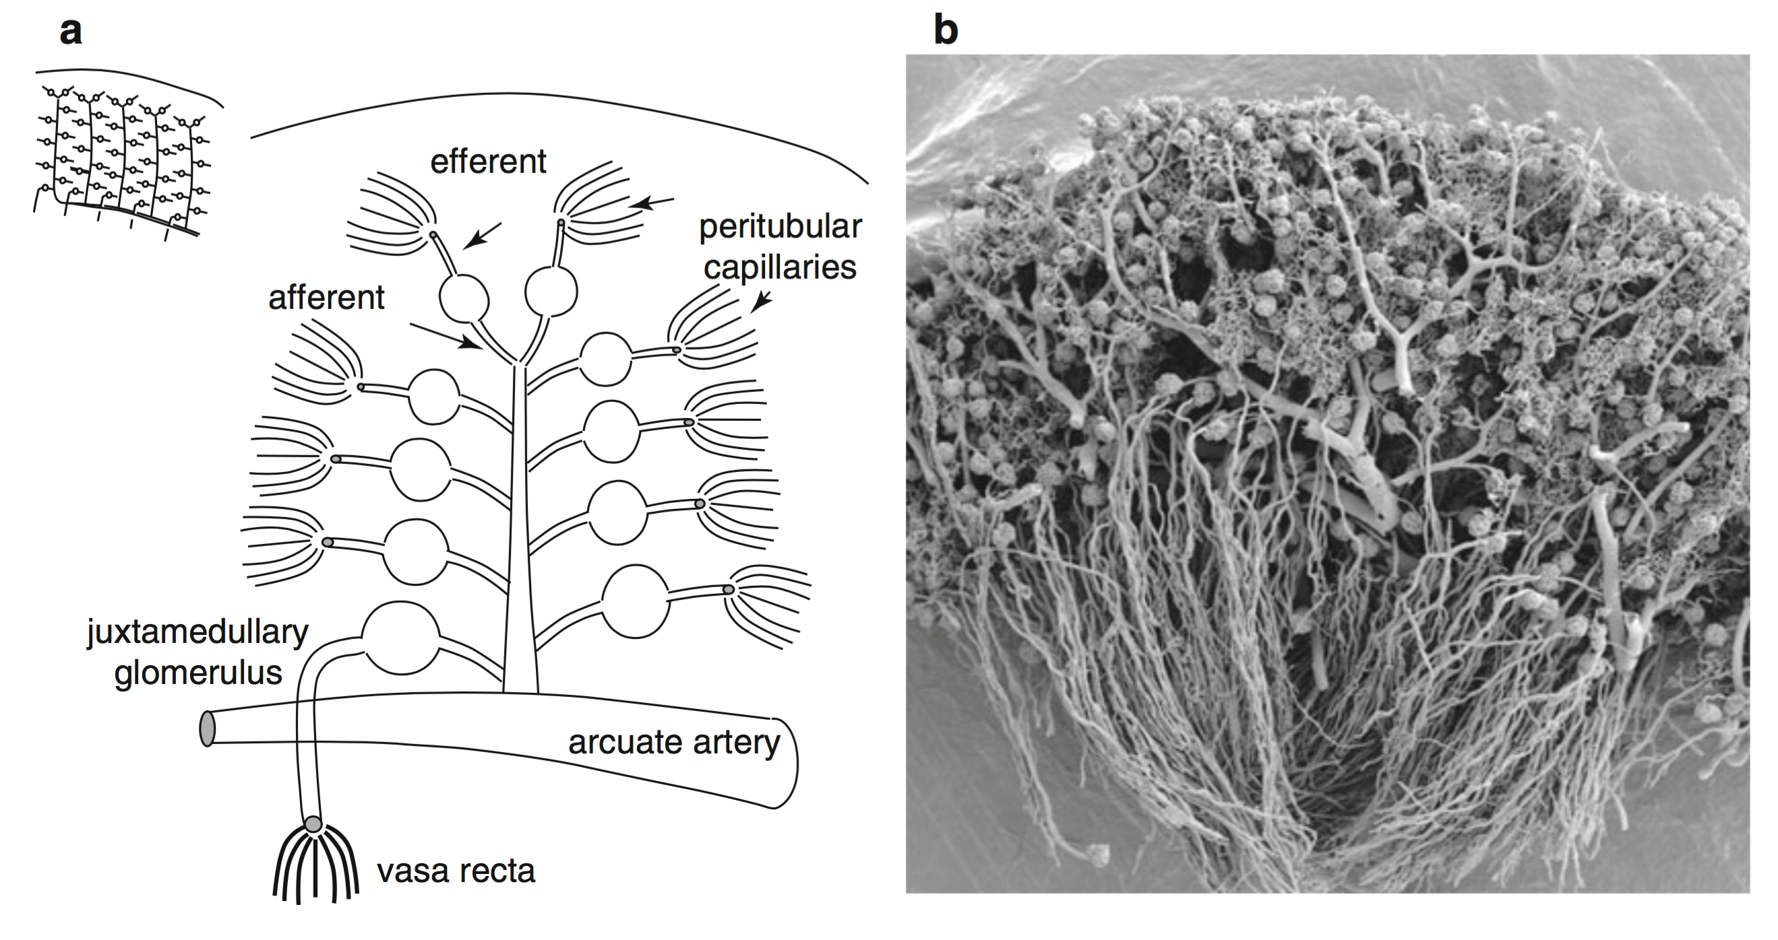
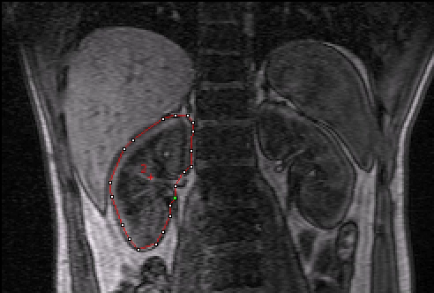

33rd Annual Scientific Meeting of the European Society for Magnetic Resonance in Medicine and Biology, Vienna/AT - Teaching Session, Sept 29th 2016 08:00-09
Measurement of Renal Perfusion and Filtration
www.esmrmb.org
Syllabus: https://github.com/arvidl/functional-kidney-imaging
E-poster: esmrmb2016.0010002
Prof. Arvid Lundervold BSc, MD, PhD
Neuroinformatics and Image Analysis Laboratory, Department of Biomedicine
Department of Radiology, Haukeland University Hospital
University of Bergen
Norway
Lerman LO, Textor SC (eds). Renal Vascular Disease, Springer 2014

Slide 2
Measurement of renal perfusion and filtration
Kidney structure and function – physiological parameters RPF and GFR
Multiscale analysis – systems medicine – radiomics
“Mass balance” and compartment models
DCE-MRI for measuring perfusion and filtration
Tracer kinetics and parameter estimation (down to single voxels)
Motion correction and kidney segmentation
Software for DCE-MRI and estimation of renal perfusion and filtration
(“open science” & “reproducible research”)

Slide 3
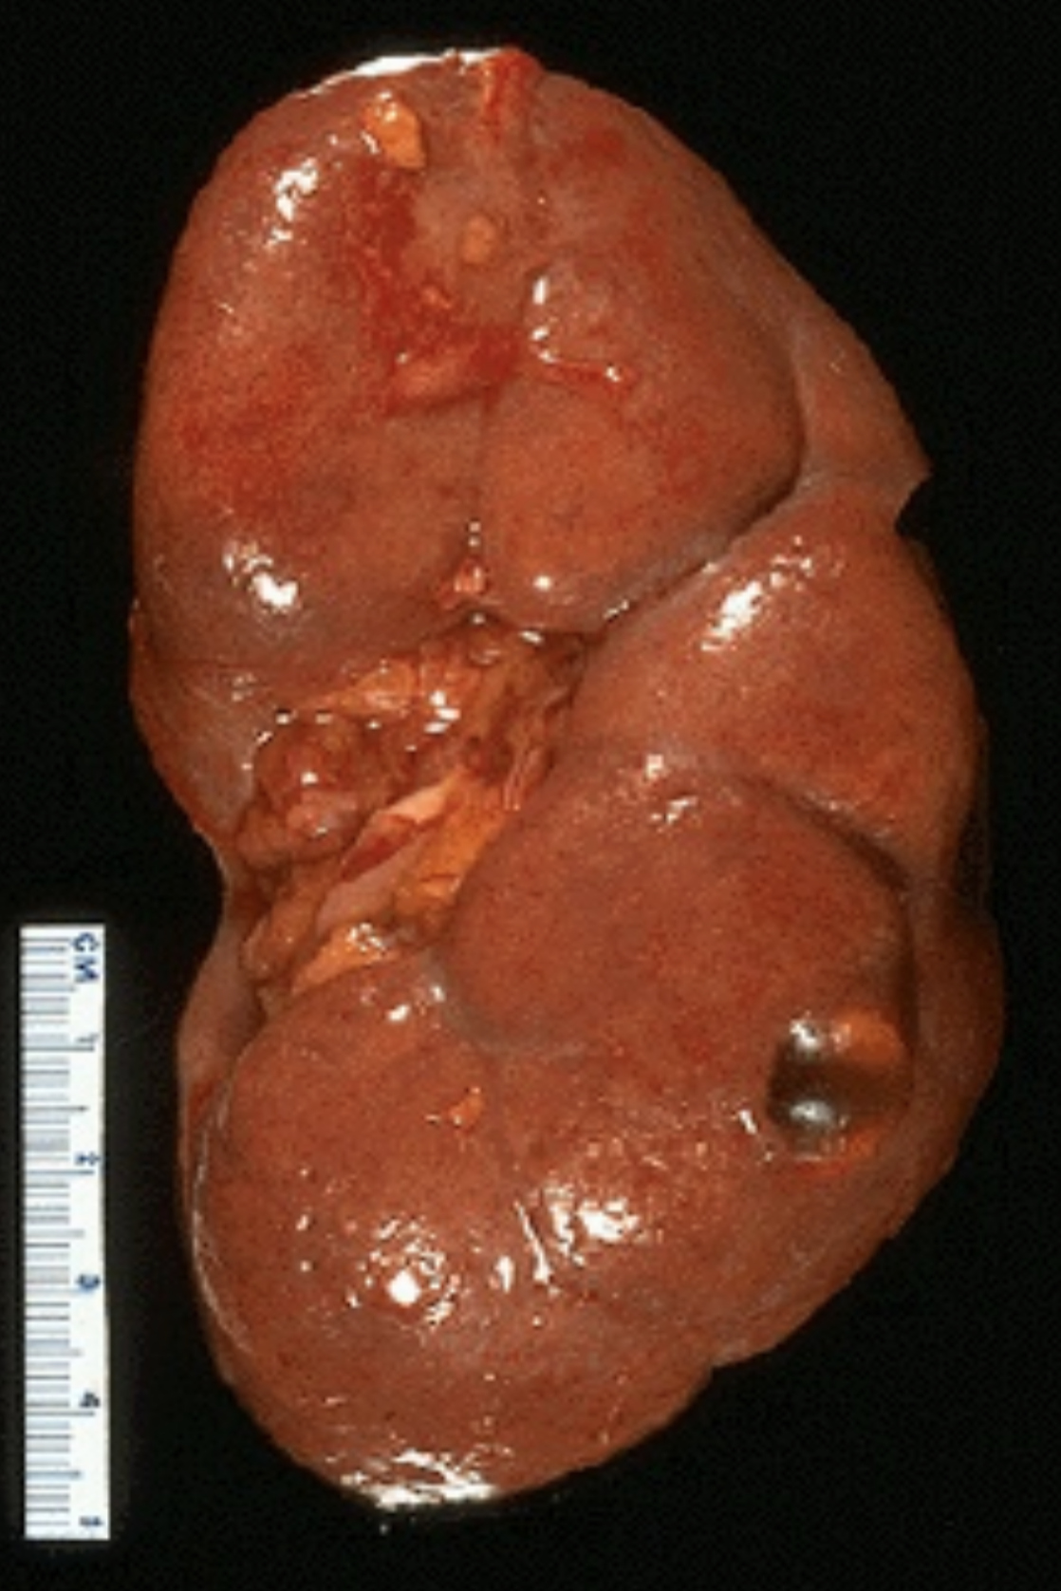
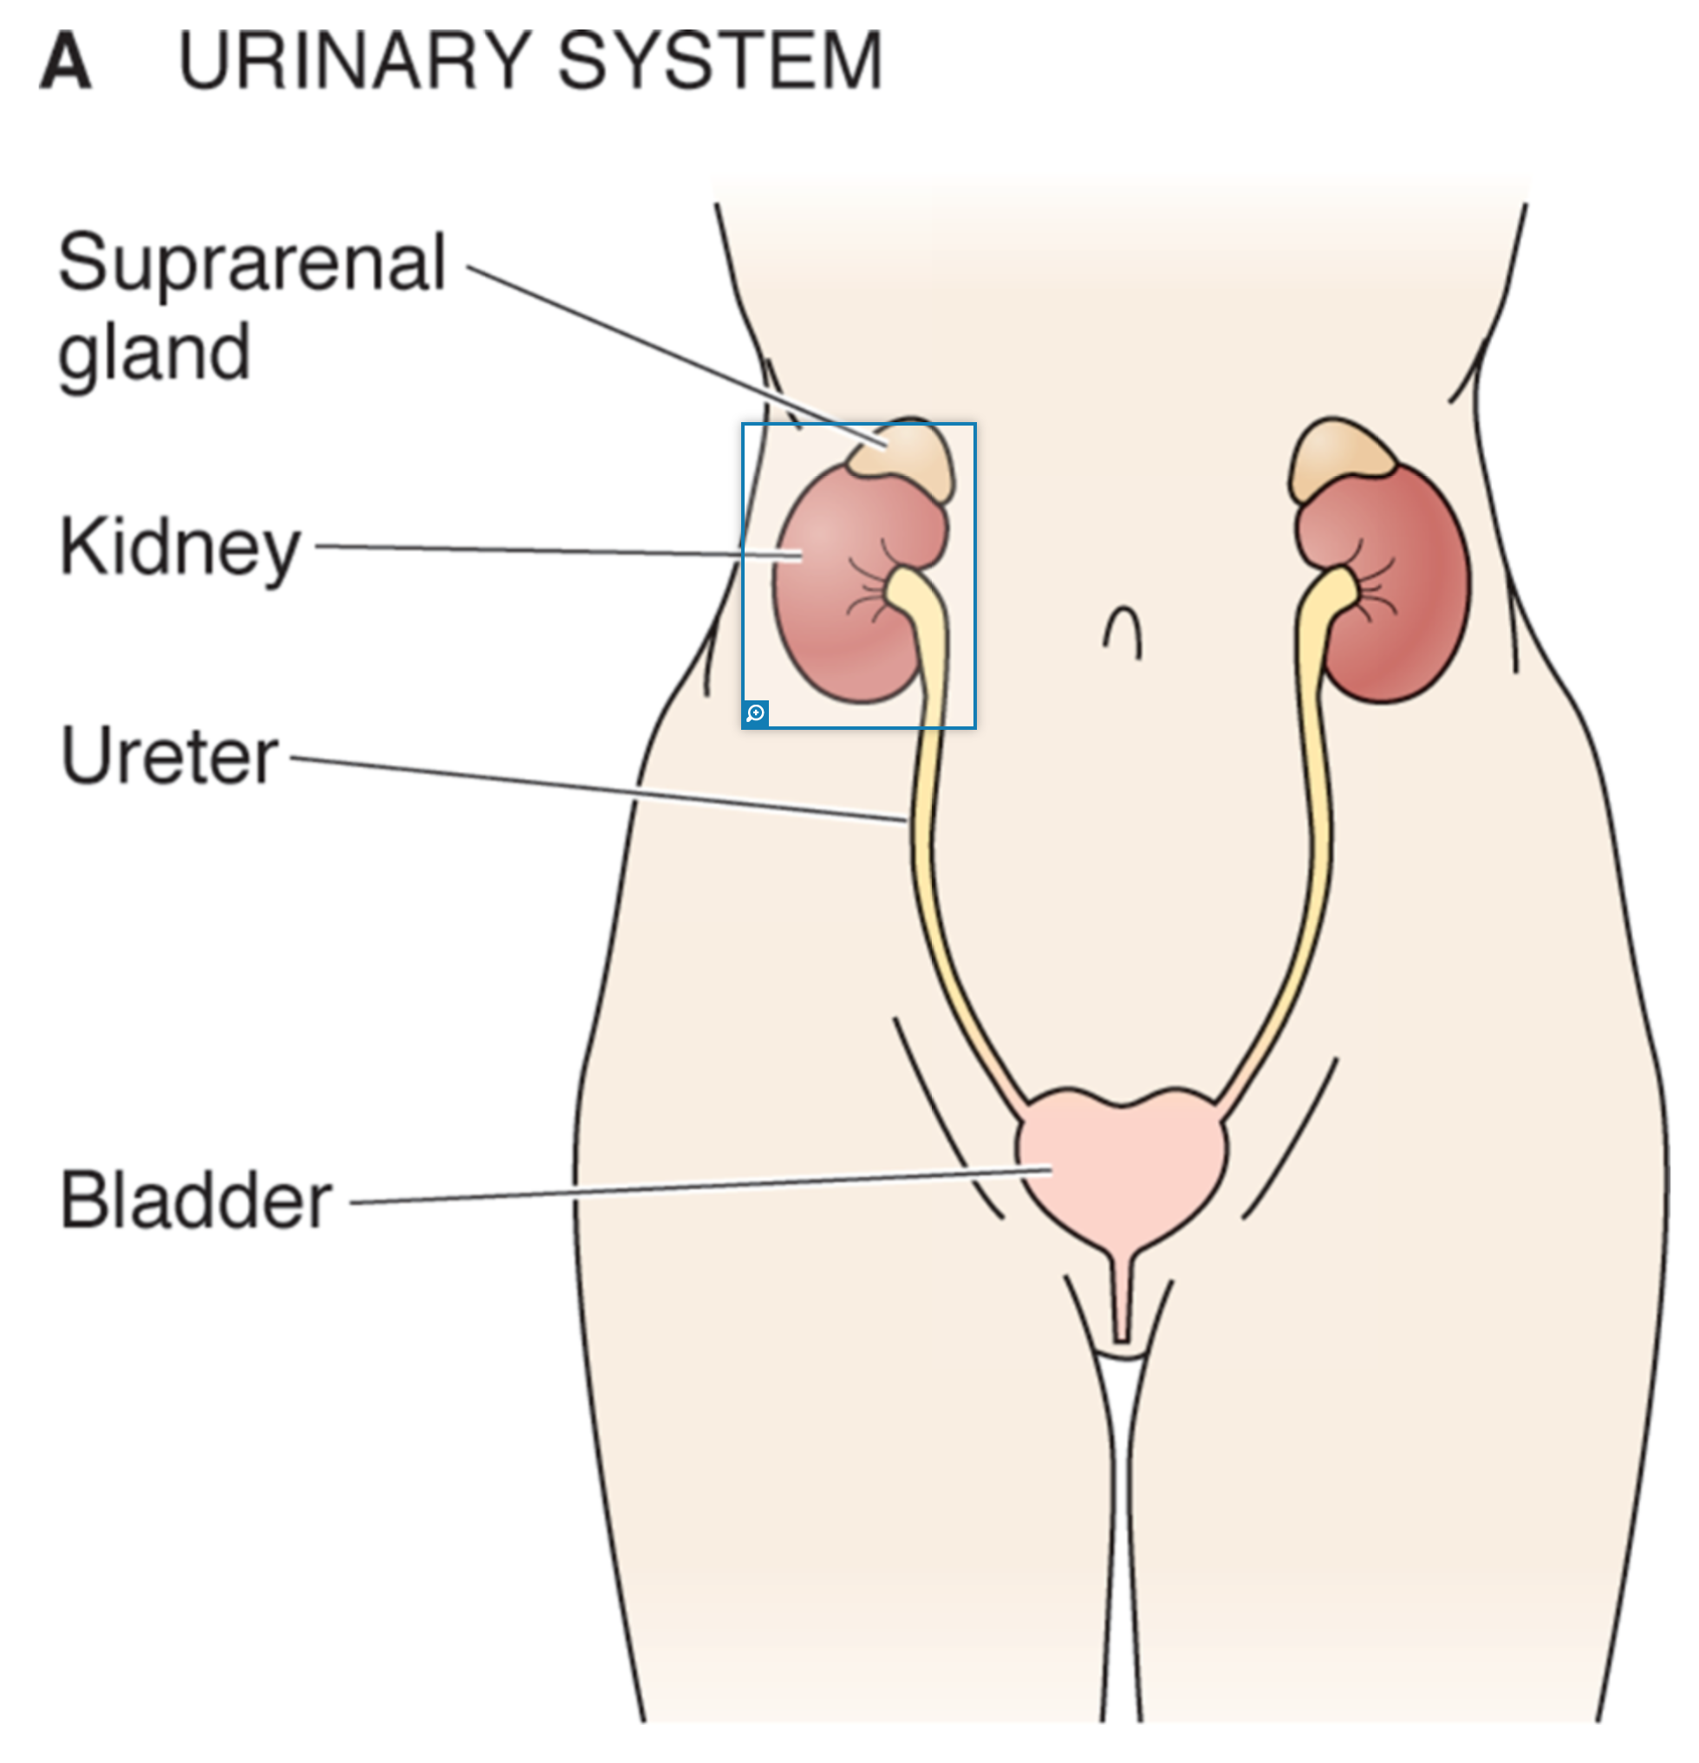
The kidney
act as filters
body homeostatsis
(fluid status, pH, electrolytes)
hormon production (renin, EPO)
<0.5% of body weight
~20% of cardiac output
Boron & Boulpaep, Medical Physiology, 3rd ed. Elsevier, 2017

Slide 4
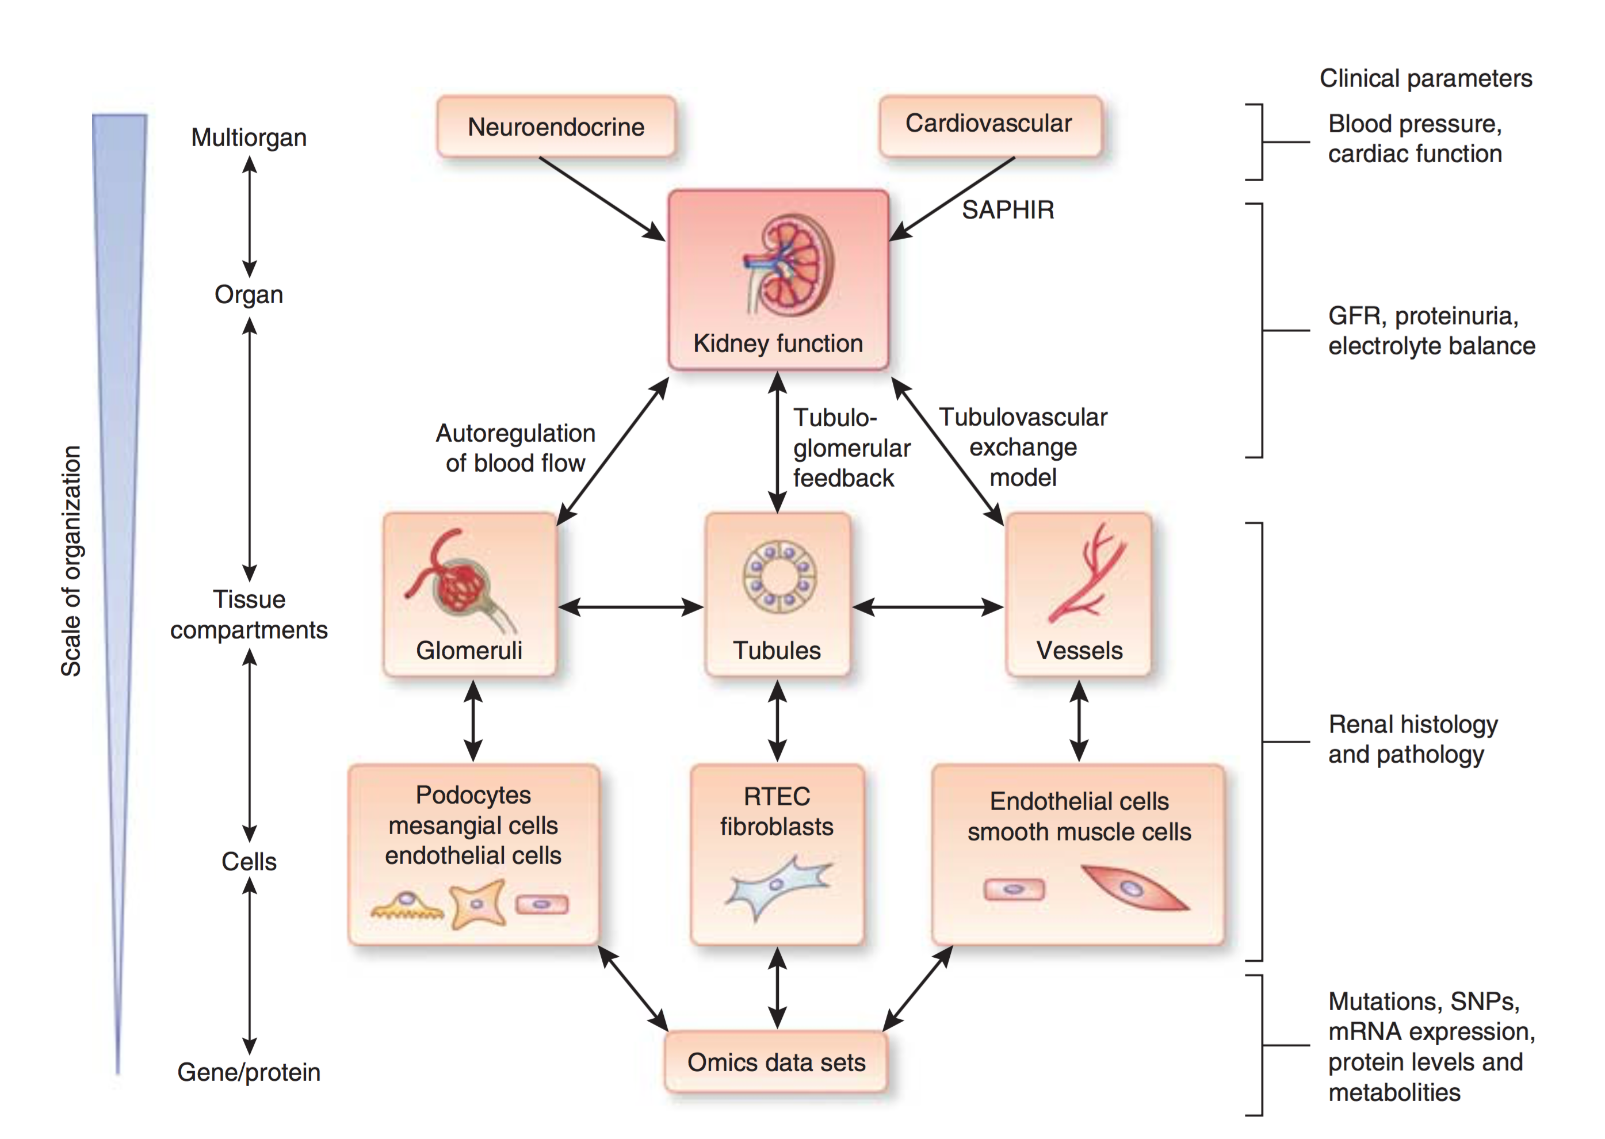
Multiscale analysis of kidney function
Normal kidney function
e.g. maintenance of
fluids, electrolytes,
and acid–base balance
and clearance of toxins
maintained by
coordinated
regulation
at different
levels
of organization
“ Radiomics “
He et al. Systems biology of kidney diseases Kidney International 2012;81:22–39

Slide 5

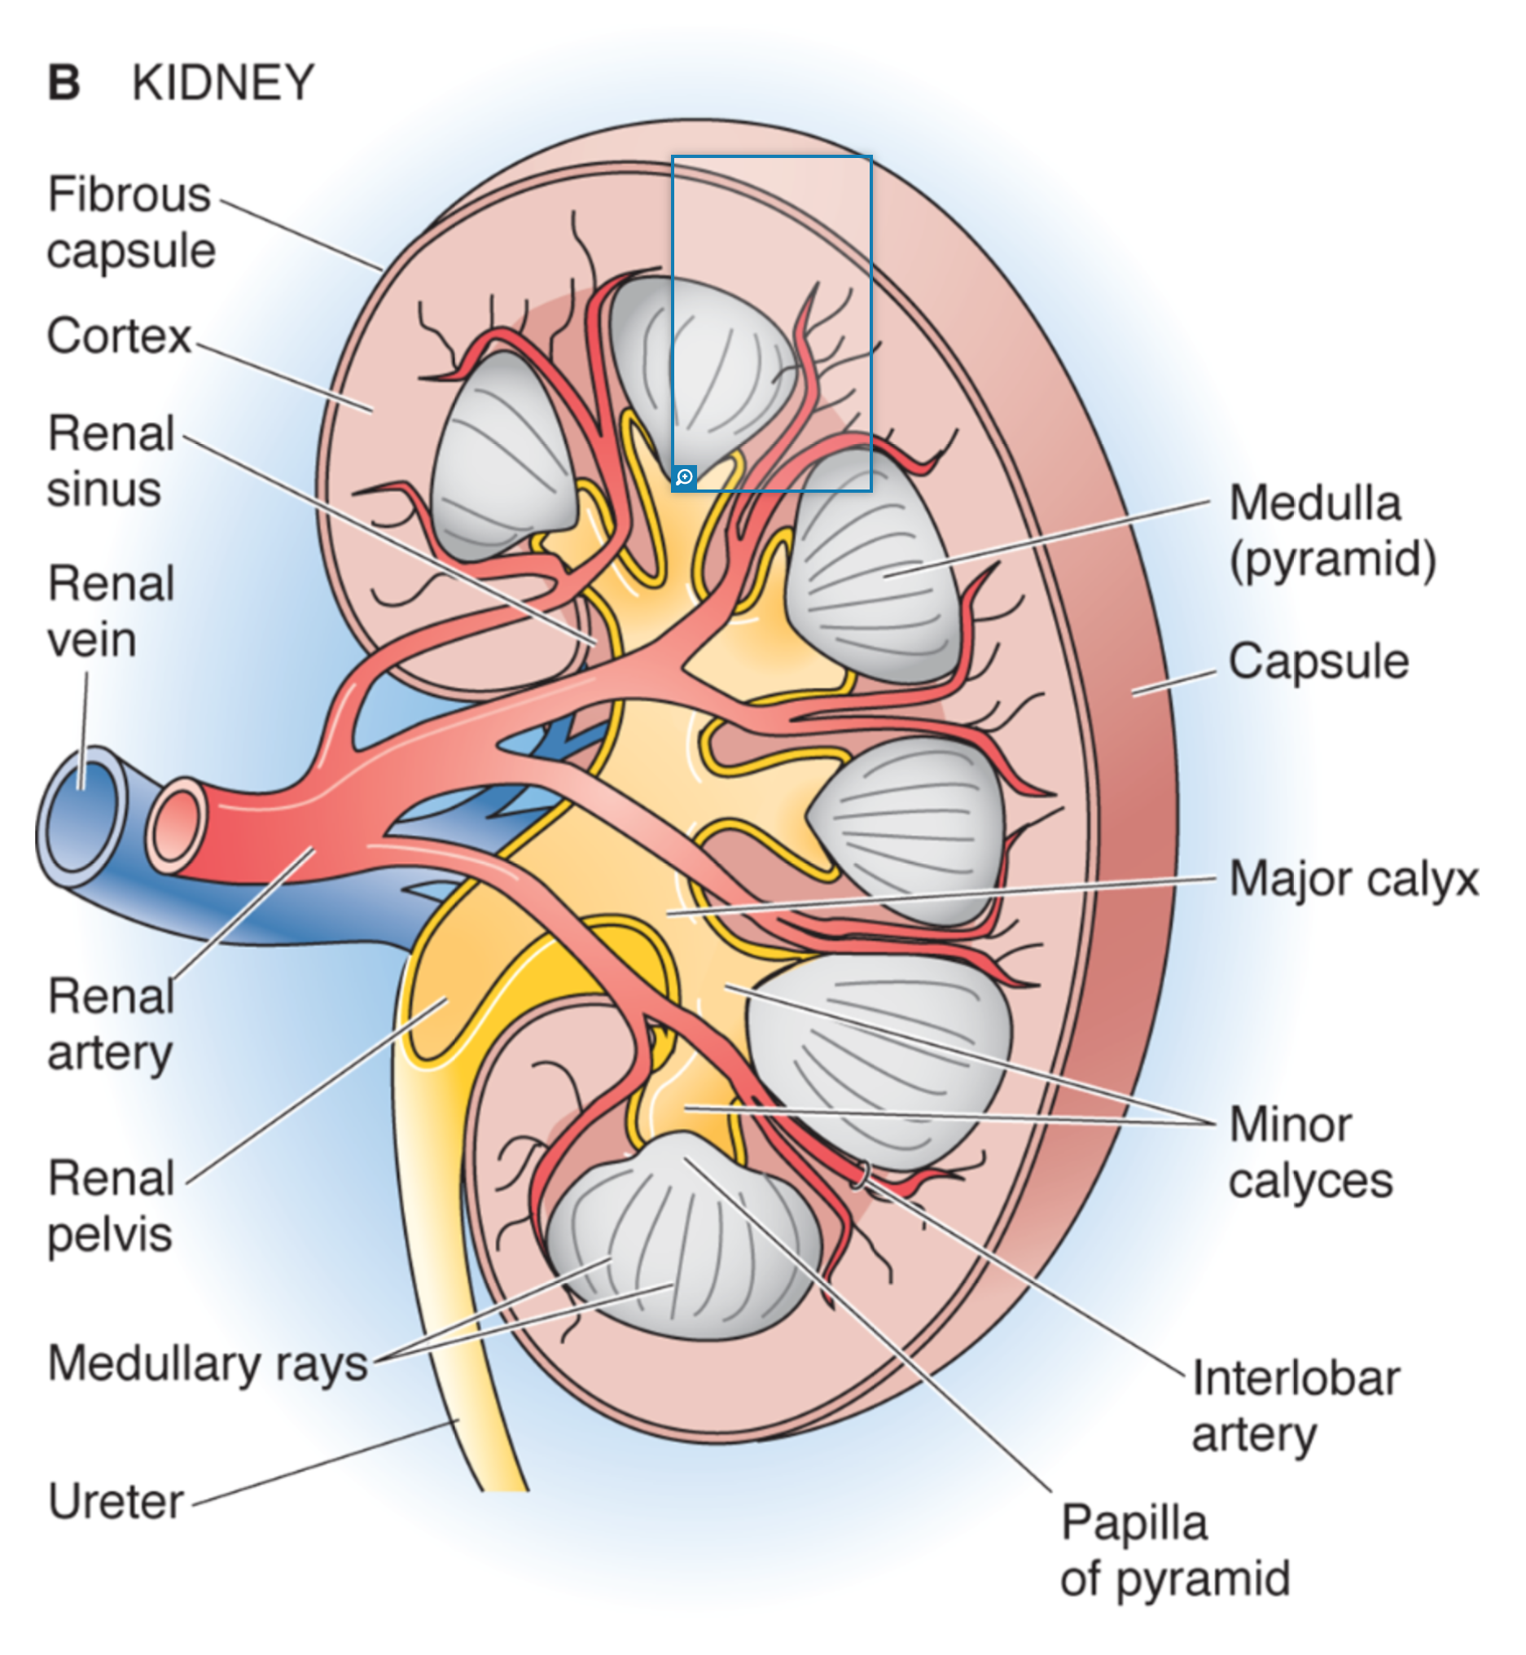
Kidney morphology
Cortex
Medulla
(pyramid)
act as filters
body homeostatsis
(fluid status, pH, electrolytes)
hormon production
<0.5% of body weight
~20% of cardiac output
Renal
pelvis
Boron & Boulpaep, Medical Physiology, 3rd ed. Elsevier, 2017

Slide 6
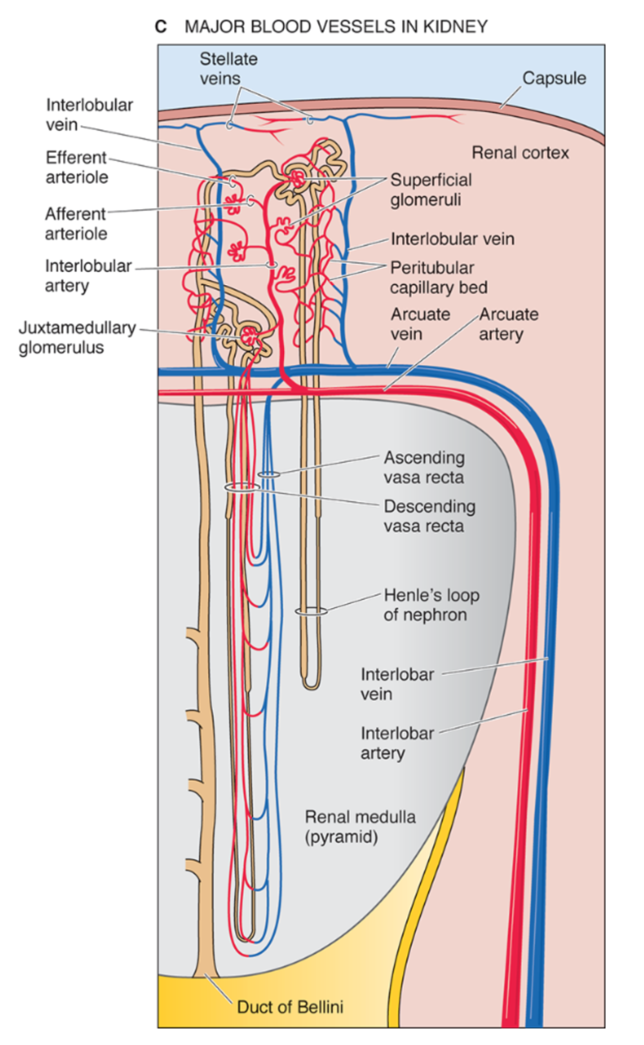


Major blood vessels
Efferent
arteriole
Glomerular
capillaries
Afferent
arteriole
Renal
vein
Renal
artery
Interlobar
vein
Interlobar
artery
Renal medulla
(pyramid)
Renal
papilla
urine
Duct of Bellini
Boron & Boulpaep, Medical Physiology, 3rd ed. Elsevier, 2017

Slide 7
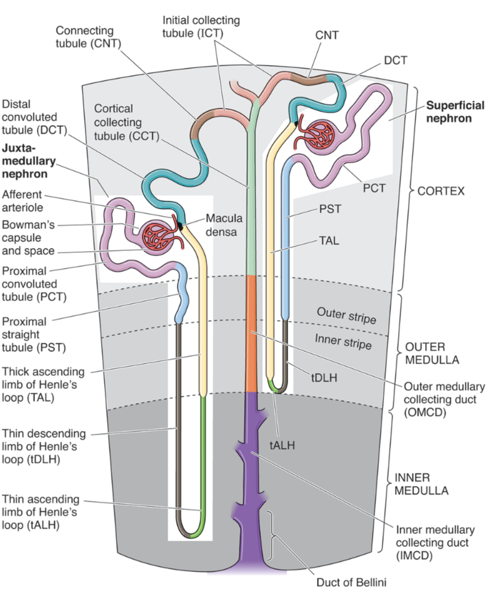
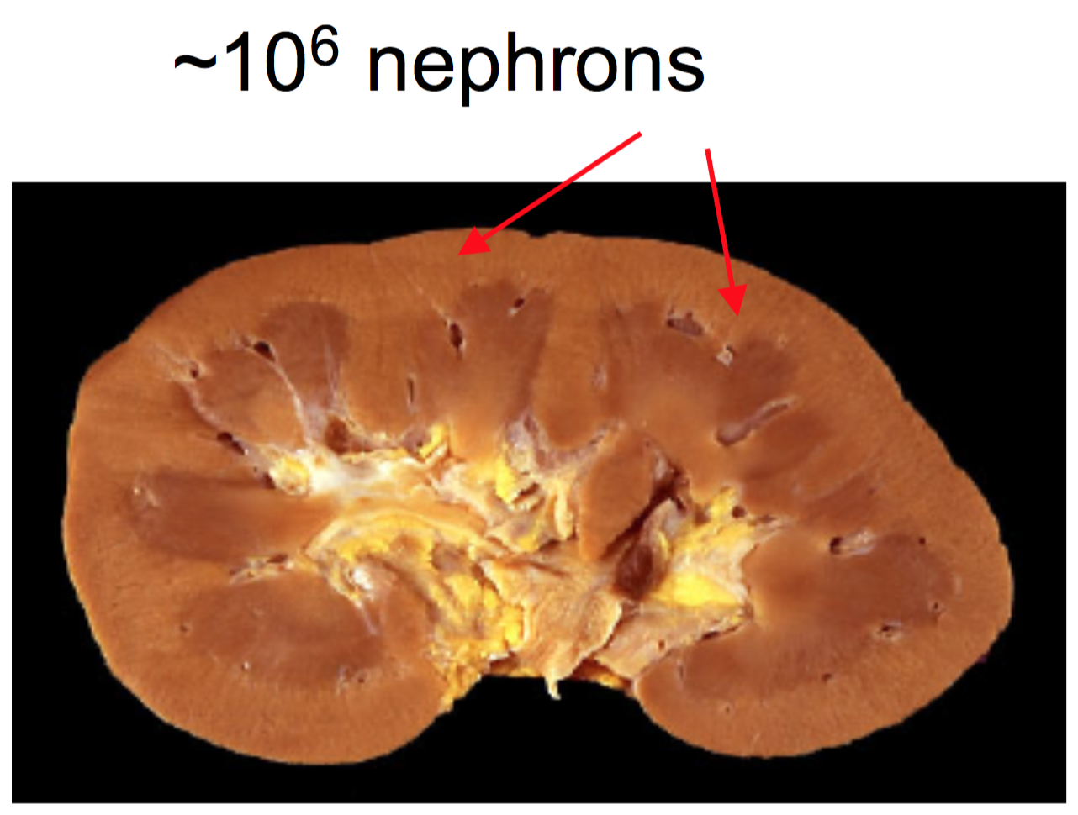
The nephron
Superficial
nephron
Juxtamedullary
nephron
CORTEX
OUTER
MEDULLA
INNER
MEDULLA
Boron & Boulpaep, Medical Physiology, 3rd ed. Elsevier, 2017

Slide 8
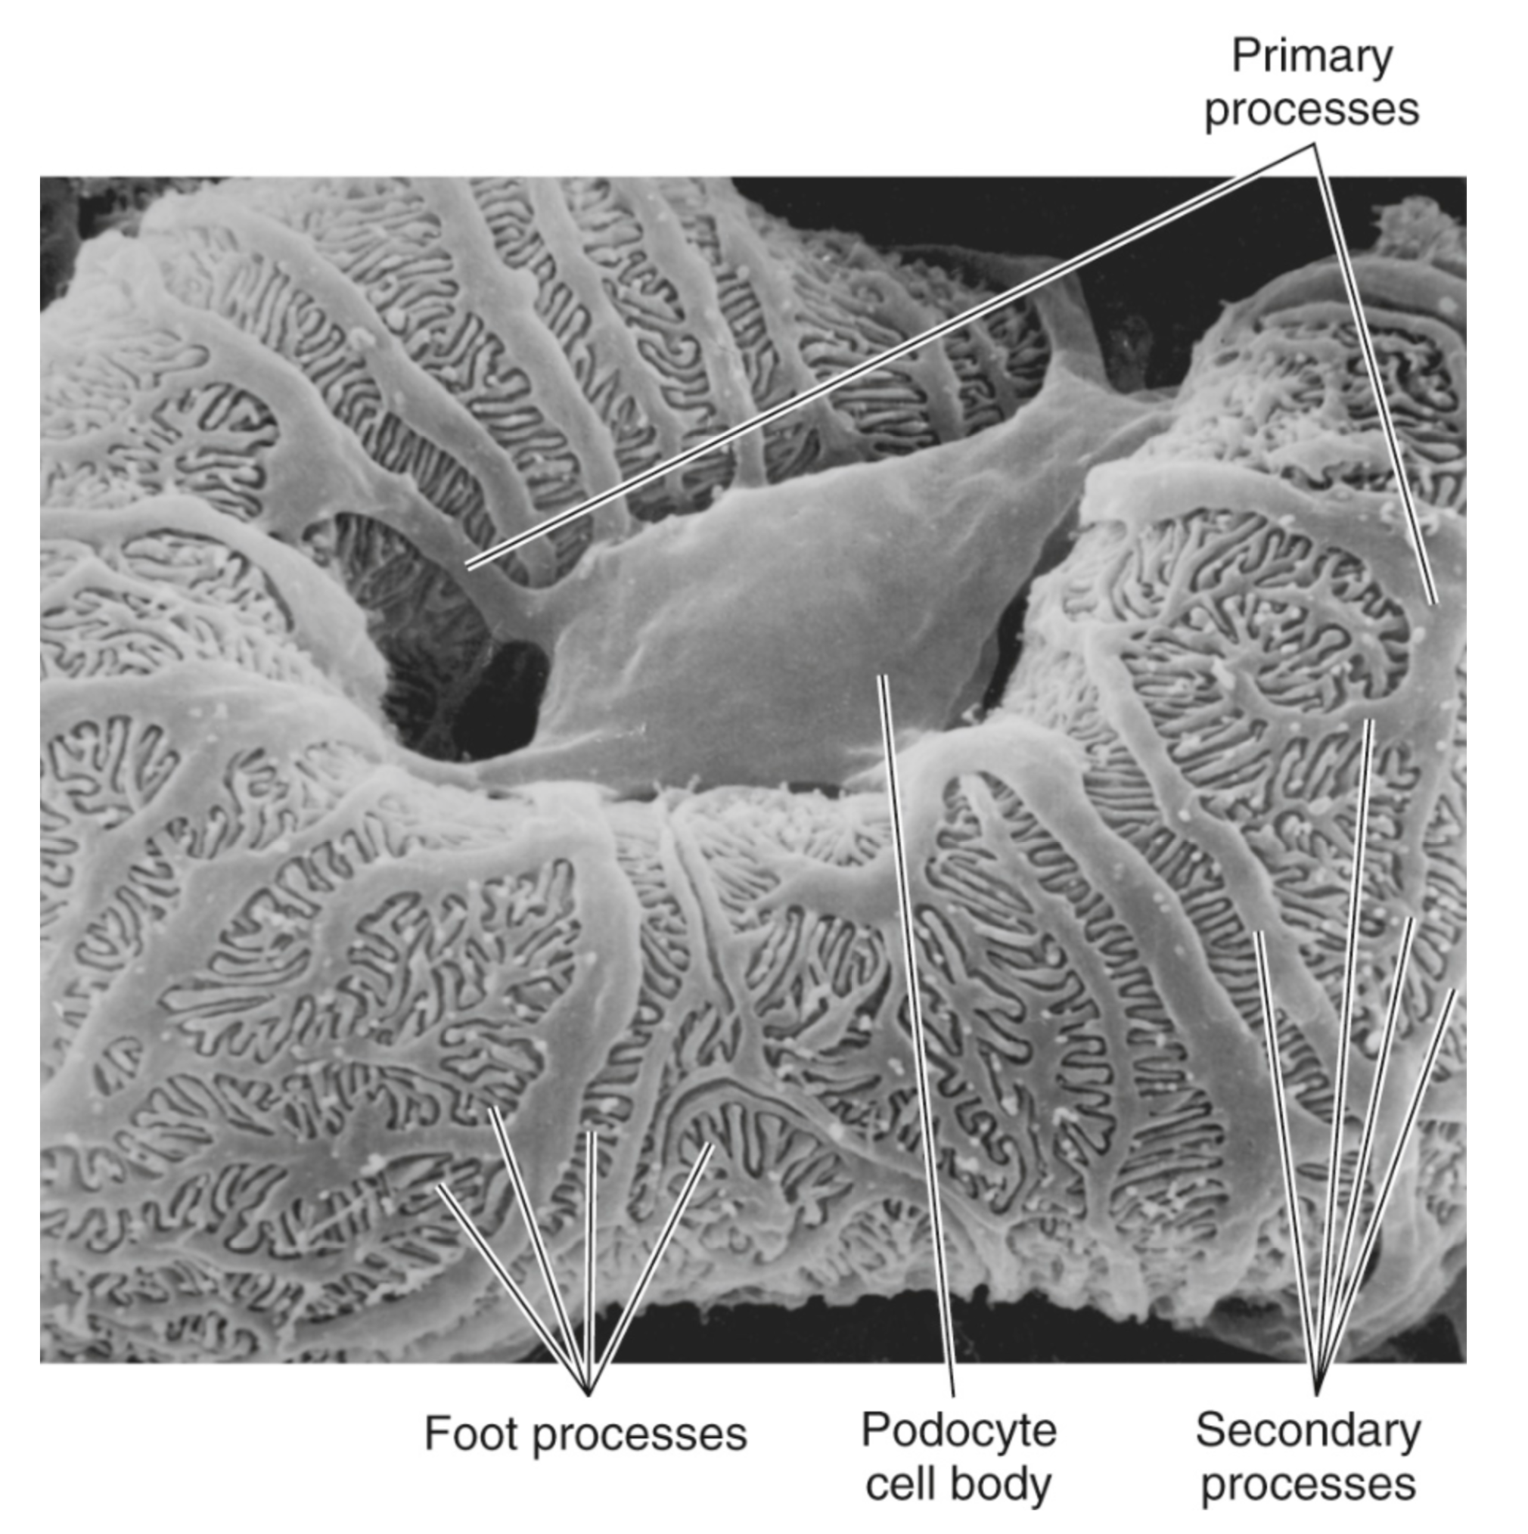
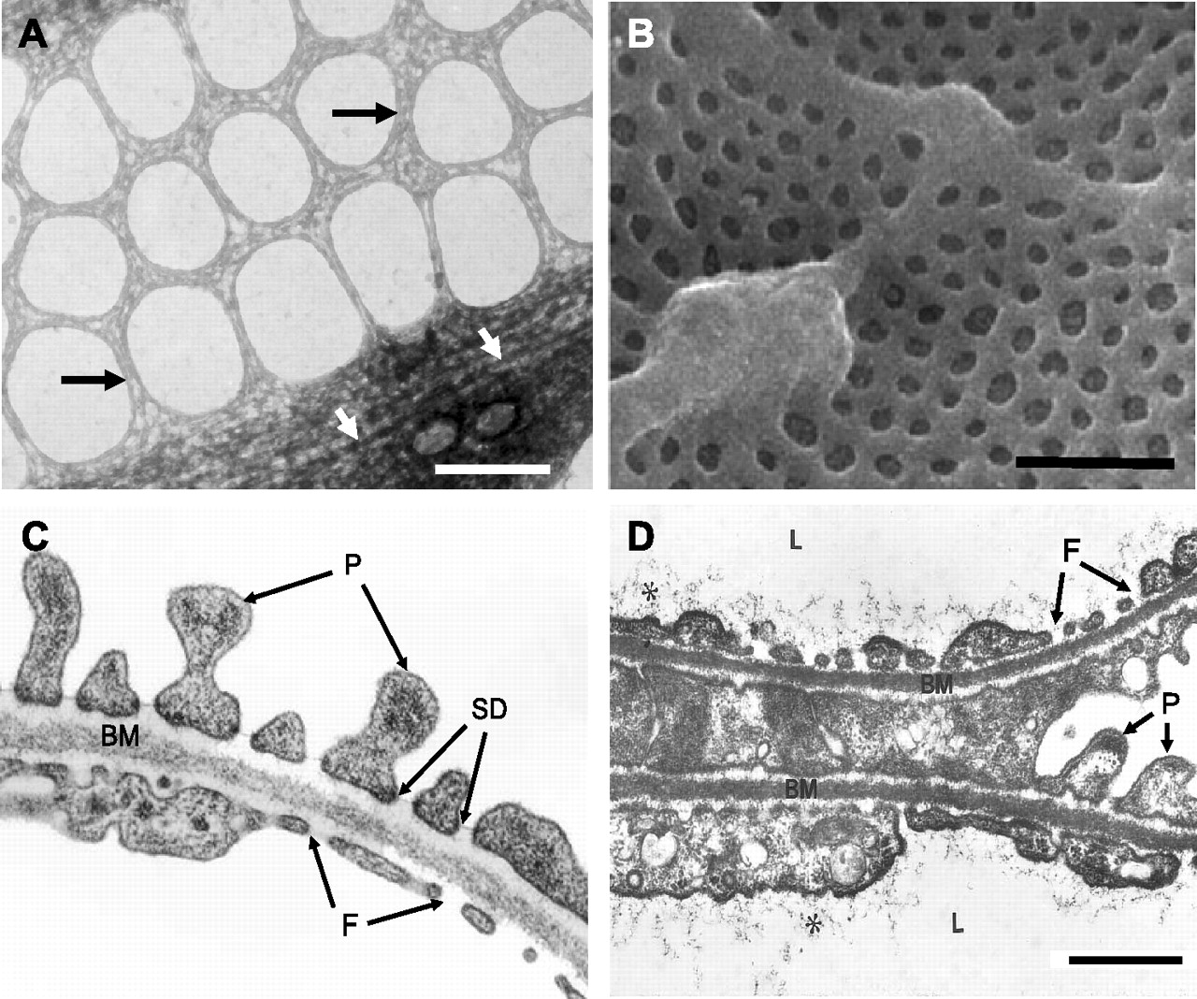
Where the filtration (GFR) takes place
Primary
processes
Primary
processes
Glomerular
capillary
covered by the
foot processes
of podocytes
Bowman’s
space
Capillary
lumen
TEM x 48000 1 μm
Foot processes
Podocyte
Cell body
Secondary
processes
Satchell & Braet Am J of Physiol Renal Physiology 2009:296(5):F947-F956.
Boron & Boulpaep, Medical Physiology, 3rd ed. Elsevier, 2017

Slide 9
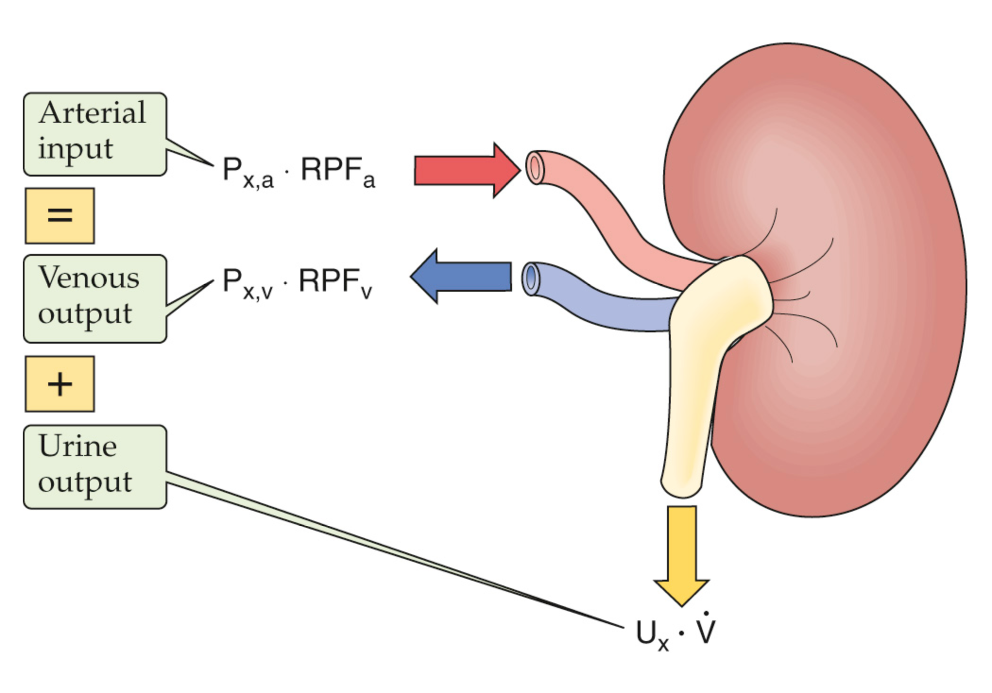
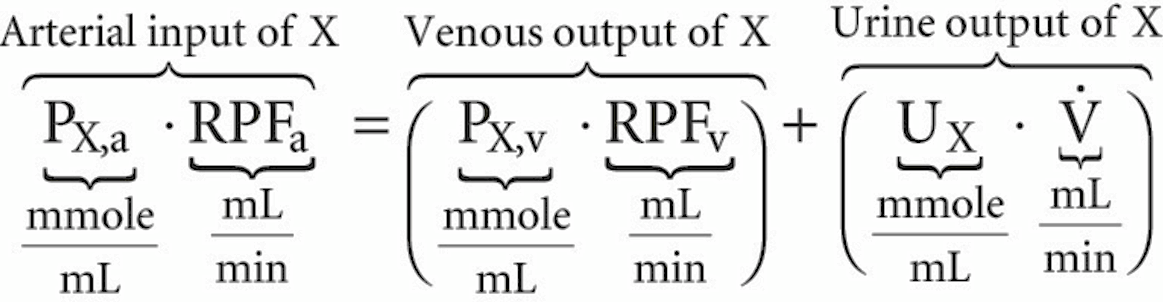
“ Mass balance “ of a solute or tracer X
( X is not synthesized, degraded, or accumulated in the kidney )
P_{X,a}
plasma concentration of X in renal artery
P_{X,v}
plasma concentration of X in renal vein
RPF_{a}
renal plasma flow in renal artery
RPF_{v}
renal plasma flow in renal vein
U_{X}
concentration of X in urine
.
Arterial input of X
Venous output of X
Urine output of X
V
urine flow (volume urine per time unit)
Boron & Boulpaep, Medical Physiology, 3rd ed. Elsevier, 2017

Slide 10
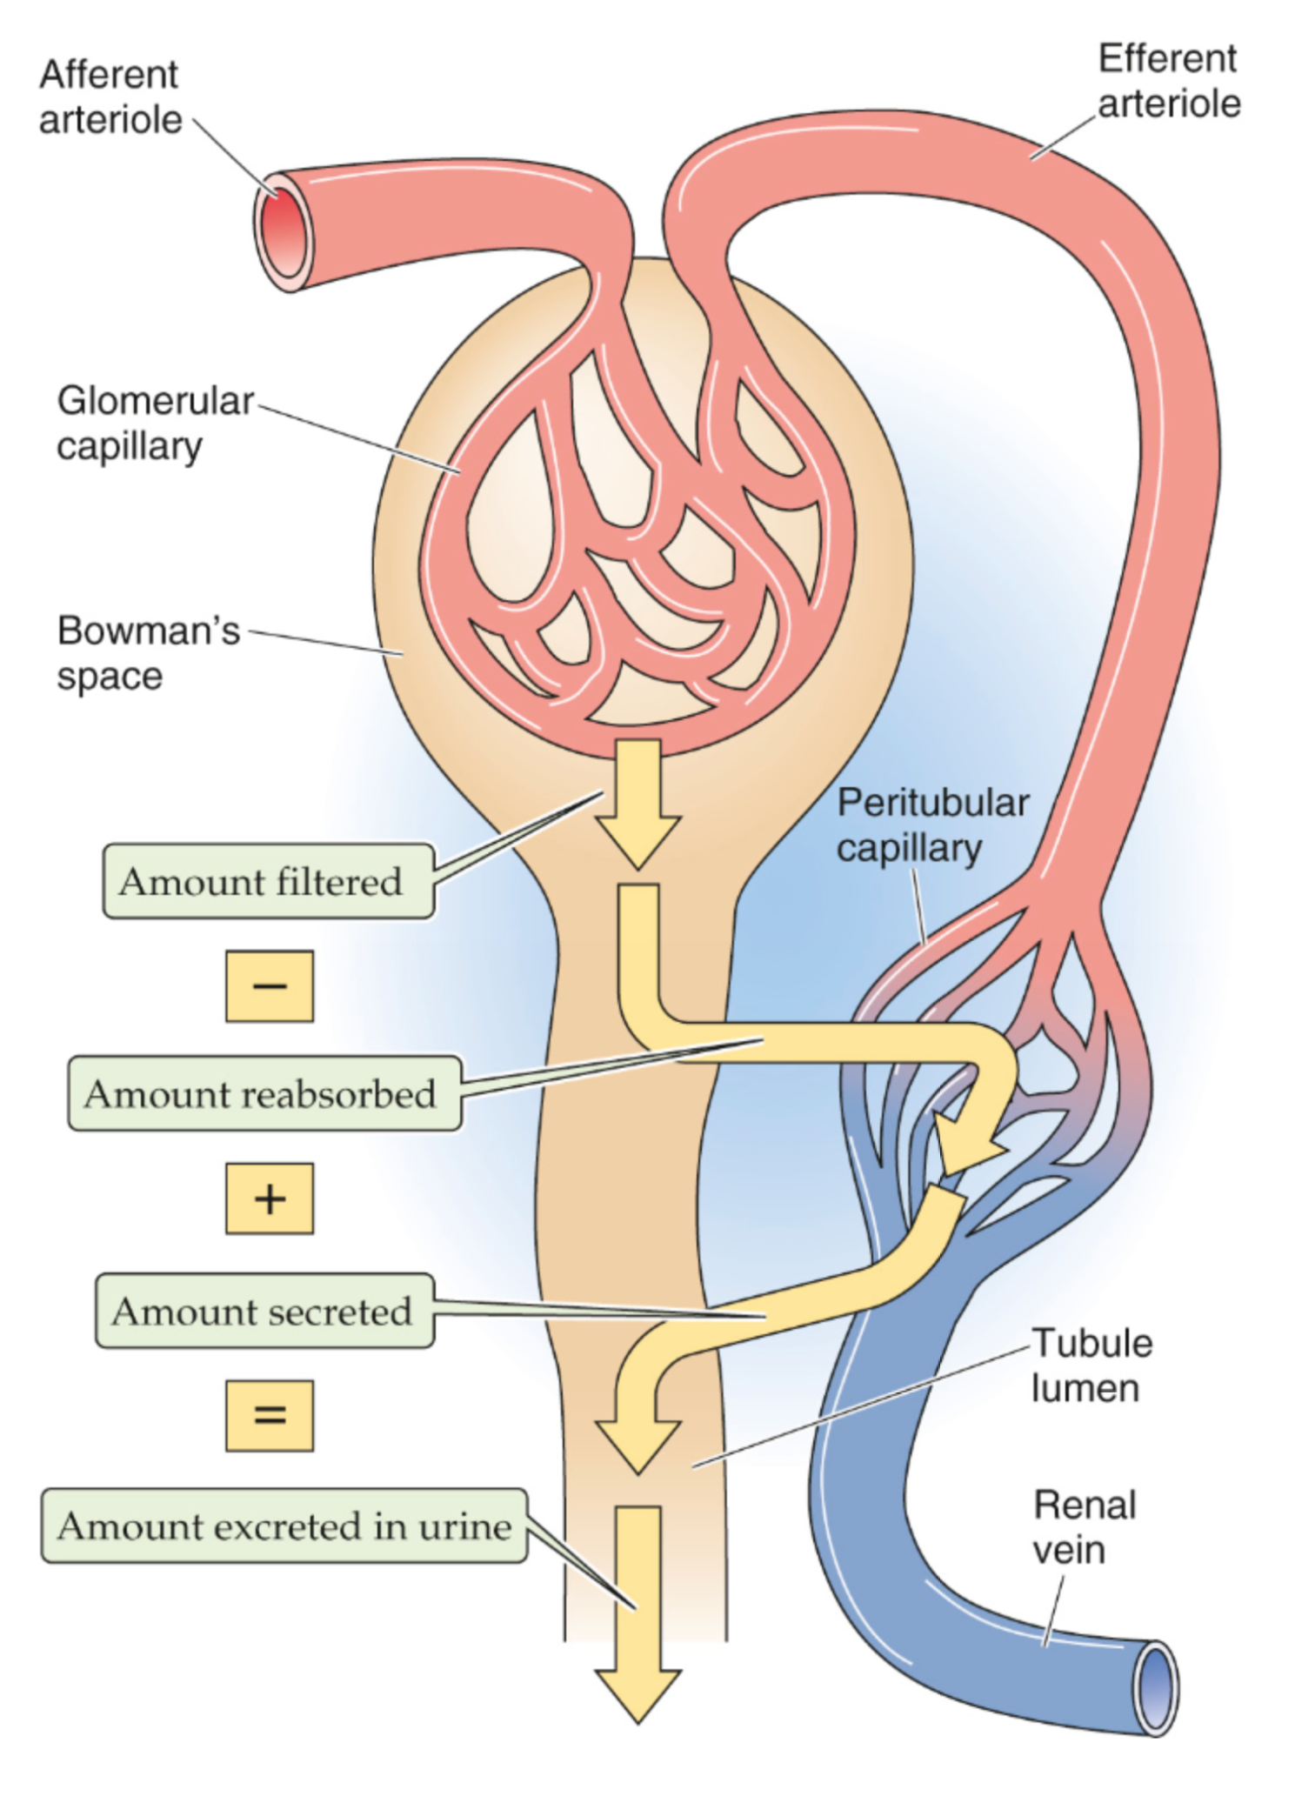
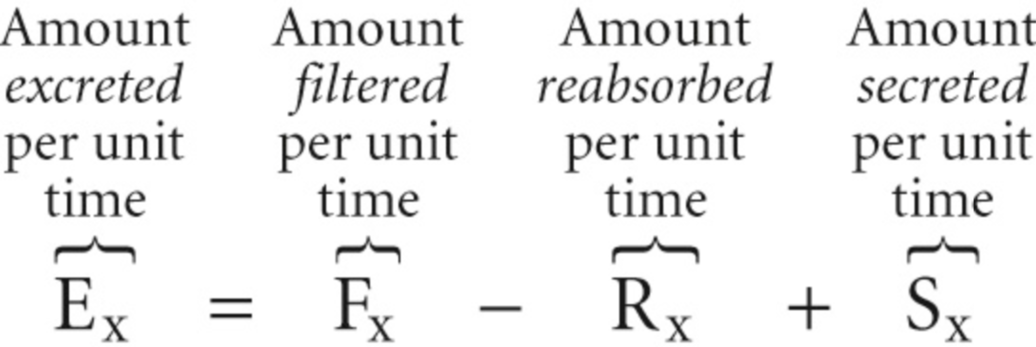
Afferent
arteriole
Boron & Boulpaep, Medical Physiology, 3rd ed. Elsevier, 2017
Efferent
arteriole
“ Mass balance “
clearance of a substance X
RPF_{a}
Glomerular
capillary
Amount
excreted
per unit
time
Amount
filtered
per unit
time
Amount
reabsorbed
per unit
time
Amount
secreted
per unit
time
Bowman’s
space
GFR
F_{X}
R_{X}
S_{X}
Tubule
lumen
Renal
vein
E_{X}

Slide 11
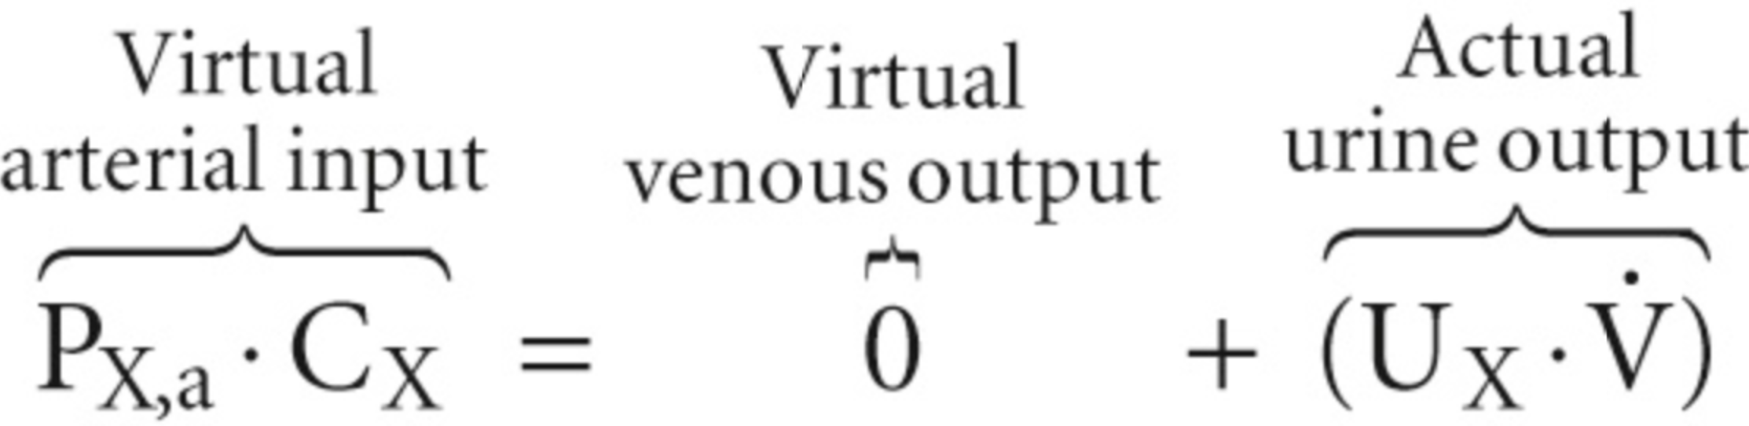
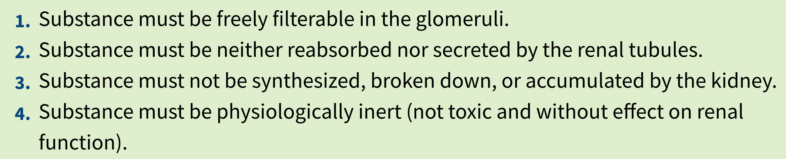
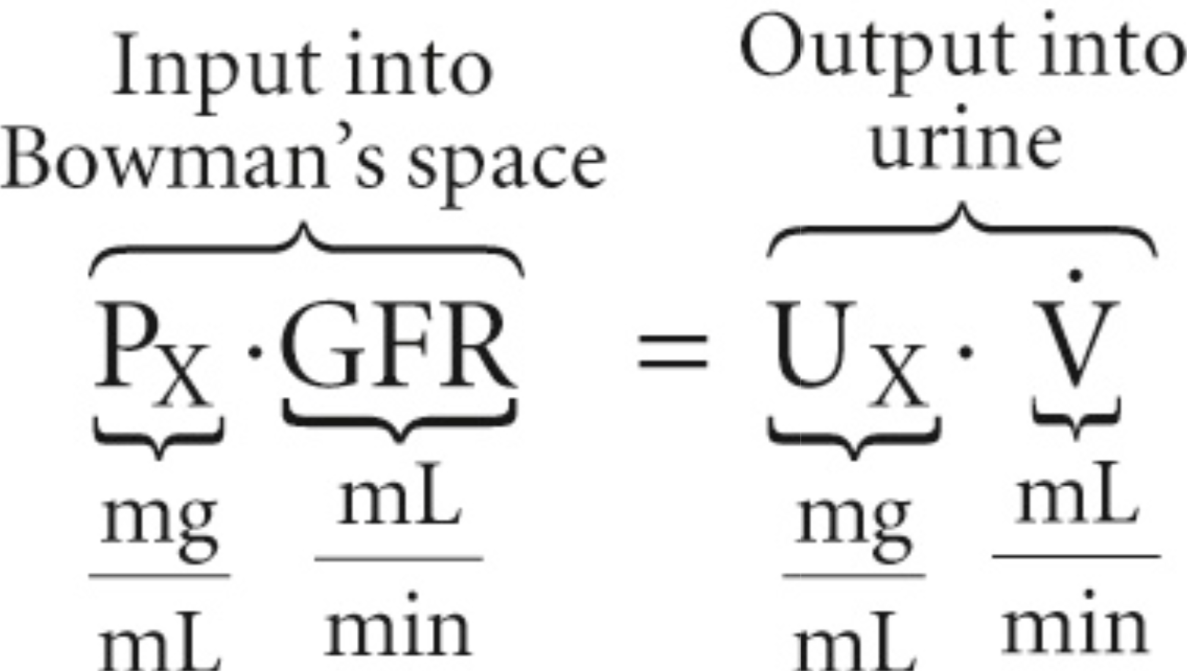
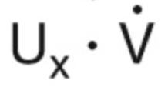
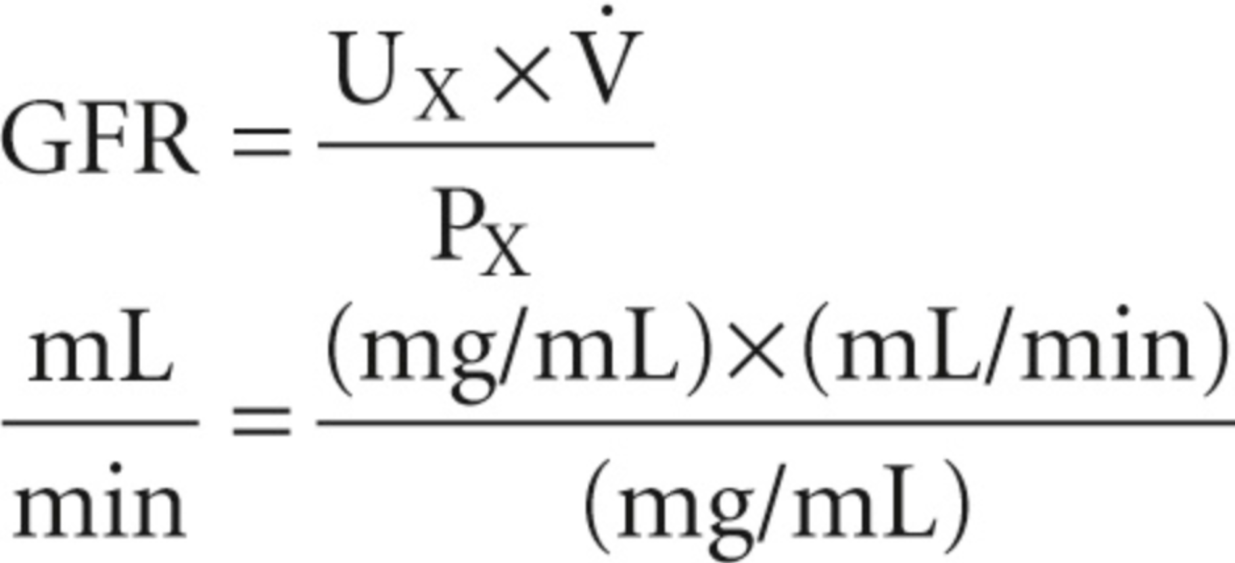
Afferent
arteriole
Boron & Boulpaep, Medical Physiology, 3rd ed. Elsevier, 2017
Efferent
arteriole
“ Mass balance “
clearance of a substance X
P_{X,a}
Glomerular
capillary
Bowman’s
space
GFR
Clearance of X, C_{X}
GFR
Tubule
lumen
Renal
vein
Input into
Bowman’s space
Output into
urine
P_{X,v} = 0

Slide 12
Afferent
arteriole
Boron & Boulpaep, Medical Physiology, 3rd ed. Elsevier, 2017
Efferent
arteriole
“ Mass balance “
clearance of a substance X
RPF_{a}
Glomerular
capillary
Bowman’s
space
GFR
F_{X}
Clearance of X, C_{X}
R_{X}
S_{X}
GFR
Tubule
lumen
Renal
vein
Input into
Bowman’s space
Output into
urine
E_{X}
C_{inulin} = GFR
~ 125 mL/min
C_{glucose} = 0
C_{PAH} = RPF_{a}
~ 600 mL/min
Filtration fraction, FF = GFR / RPF
~ 0.2

Slide 13
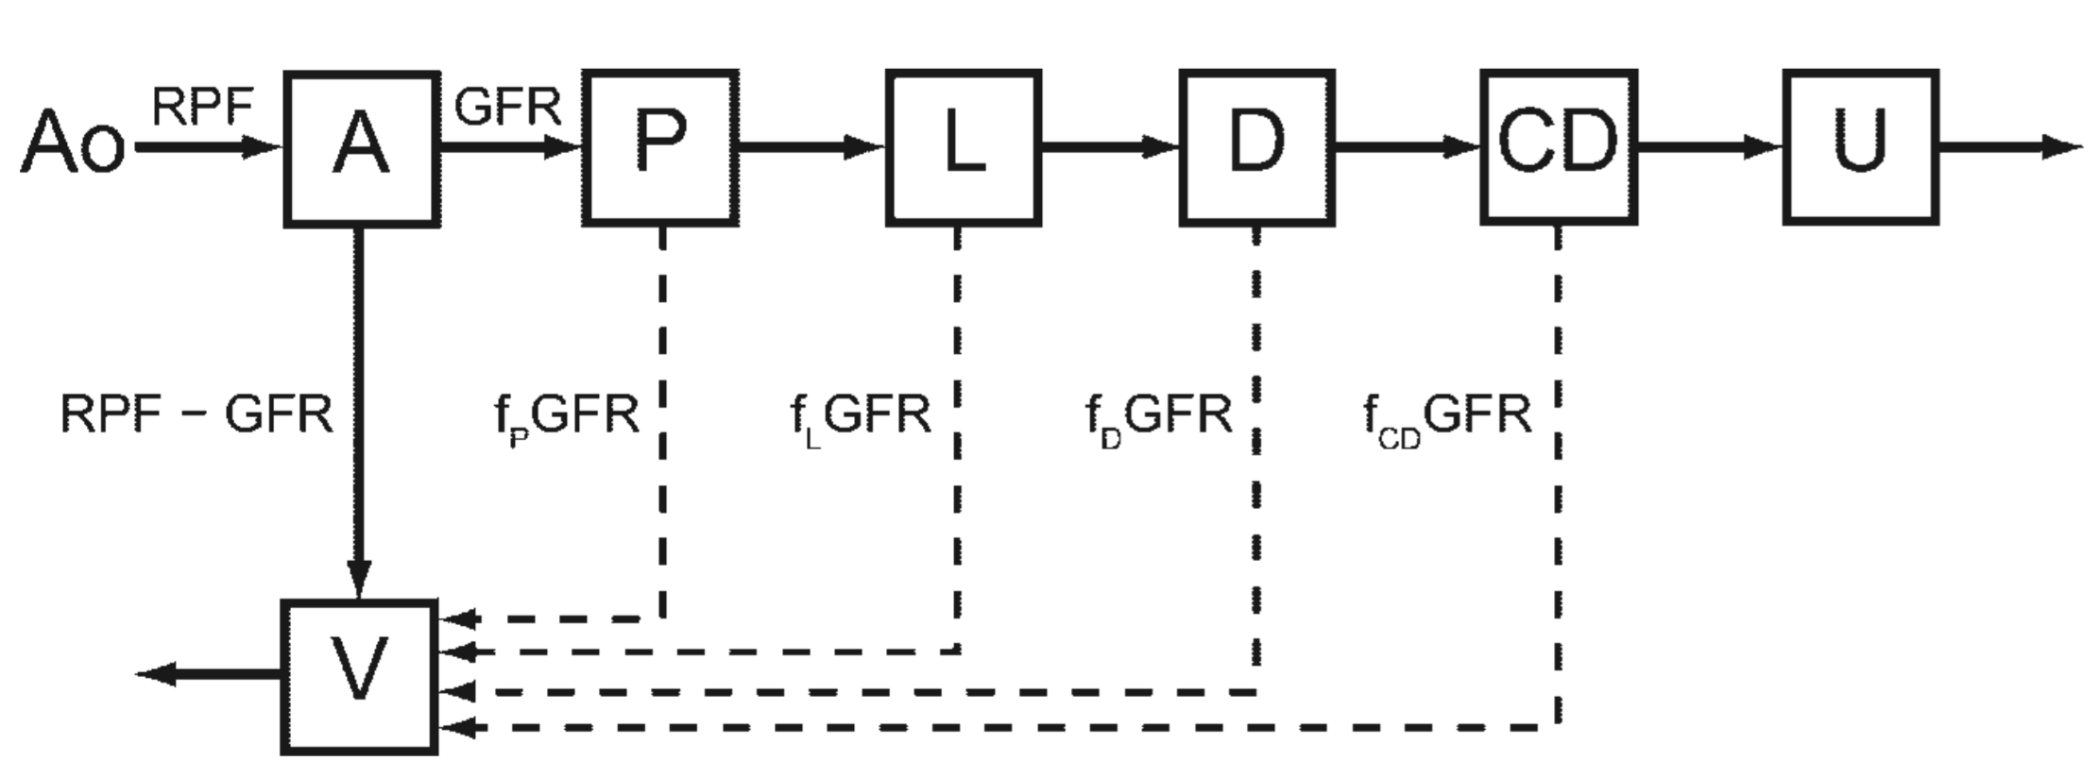

Multi-compartment modeling of renal perfusion and filtration
(A model for determination of single-kidney GFR)
RPF
GFR
Dashed lines represent tracer-free fluid resorption, in terms of fractions of GFR: f_{P}, f_{L}, f_{D}, f_{CD}
Ao - aorta
A - intrarenal arteries and glomerular vessels
P - proximal convoluted tubule
L - loop of Henle
D - distal convoluted tubule
CD - collecting duct
V - vasa recta and veins
U - ureter
Lee VS et al. Renal function measurements from MR renography and a simplified multicompartmental model. Am J Physiol Renal Physiol 2007;292:F1548–F1559.

Slide 14
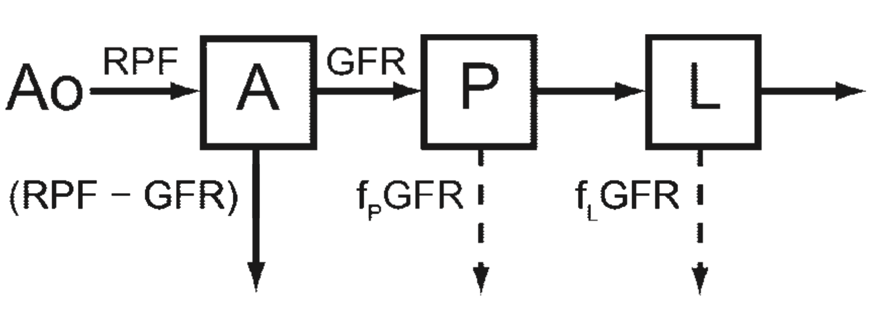
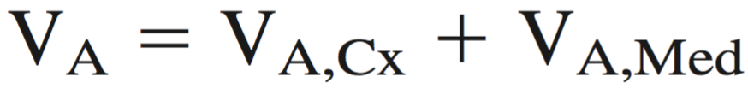
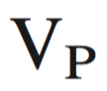
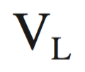
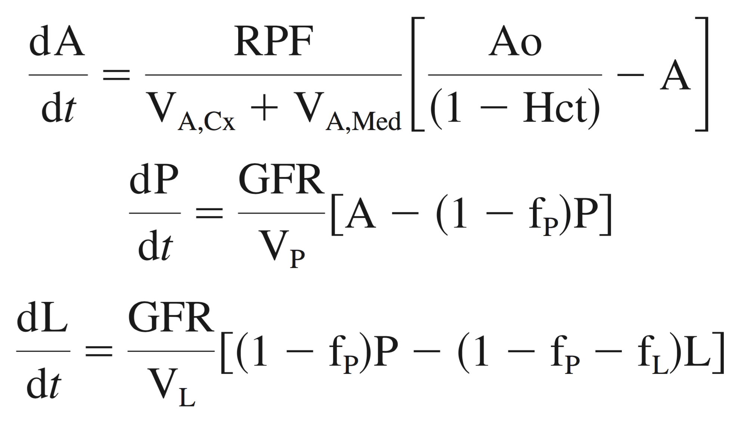
Three-compartment modeling of renal perfusion and filtration
Simplified three-compartment model for
determination of single-kidney GFR:
Conservation of mass (simplified model):
X = tracer substance (e.g. Gd)
(1 – f_{P}) GFR
(1 – f_{P} - f_{L}) GFR
cortex medulla
[mL]
Dashed lines represent tracer-free fluid resorption, in terms of fractions of GFR: f_{P}, f_{L}.
- volume of P [mL]
- volume of L [mL]
Ao (t) - aorta (AIF) [mM X/ mL whole blood]
A (t) - intrarenal arteries and glomerular vessels
[mM X / mL plasma]
P (t) - proximal convoluted tubule [mM X / mL tubular fluid]
L (t) - loop of Henle [mM X / mL tubular fluid]
RPF = Renal plasma flow [mL/min]
GFR = Glomerular filtration rate [mL/min]
Hct = hematocrit, (1 – Hct) = plasma fraction
System of 3 coupled ordinary differential equations, ODEs
Lee VS et al. Renal function measurements from MR renography and a simplified multicompartmental model. Am J Physiol Renal Physiol 2007;292:F1548–F1559.

Slide 15
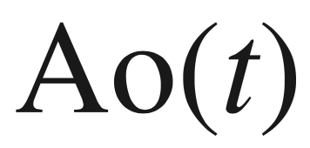
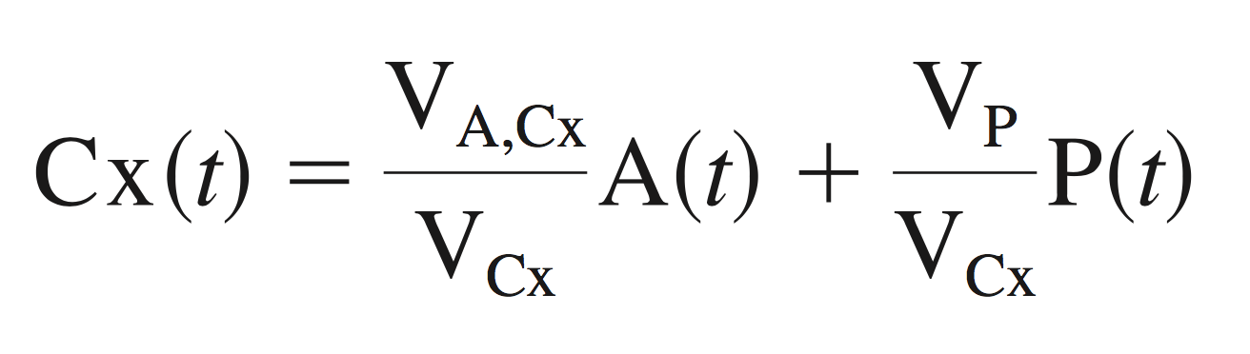
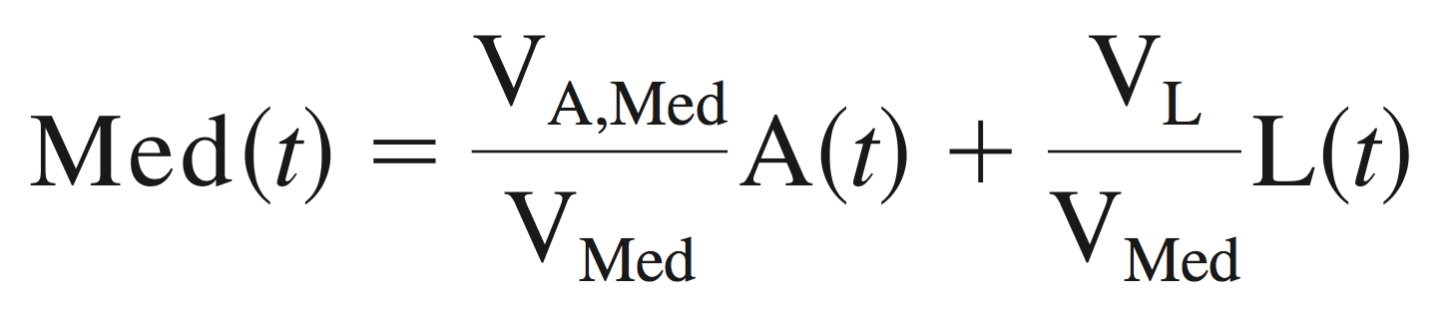
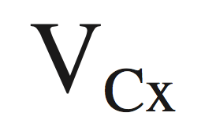
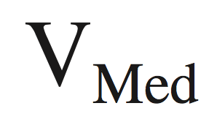
Three-compartment modeling of renal perfusion and filtration
Simplified three-compartment model for
determination of single-kidney GFR:
Conservation of mass
(1 – f_{P}) GFR
(1 – f_{P} - f_{L}) GFR
Parameters estimated:
MR measurements:
(with some simplifying assumptions)
RPF
The AIF, from MR renography (DCE-MRI)
GFR
from MR renography
f_{P}
f_{L}
MR renography
V_{A,Cx}
The volumes and from segmented 3D MRI
V_{A,Med}
Lee VS et al. Renal function measurements from MR renography and a simplified multicompartmental model. Am J Physiol Renal Physiol 2007;292:F1548–F1559.

Slide 16

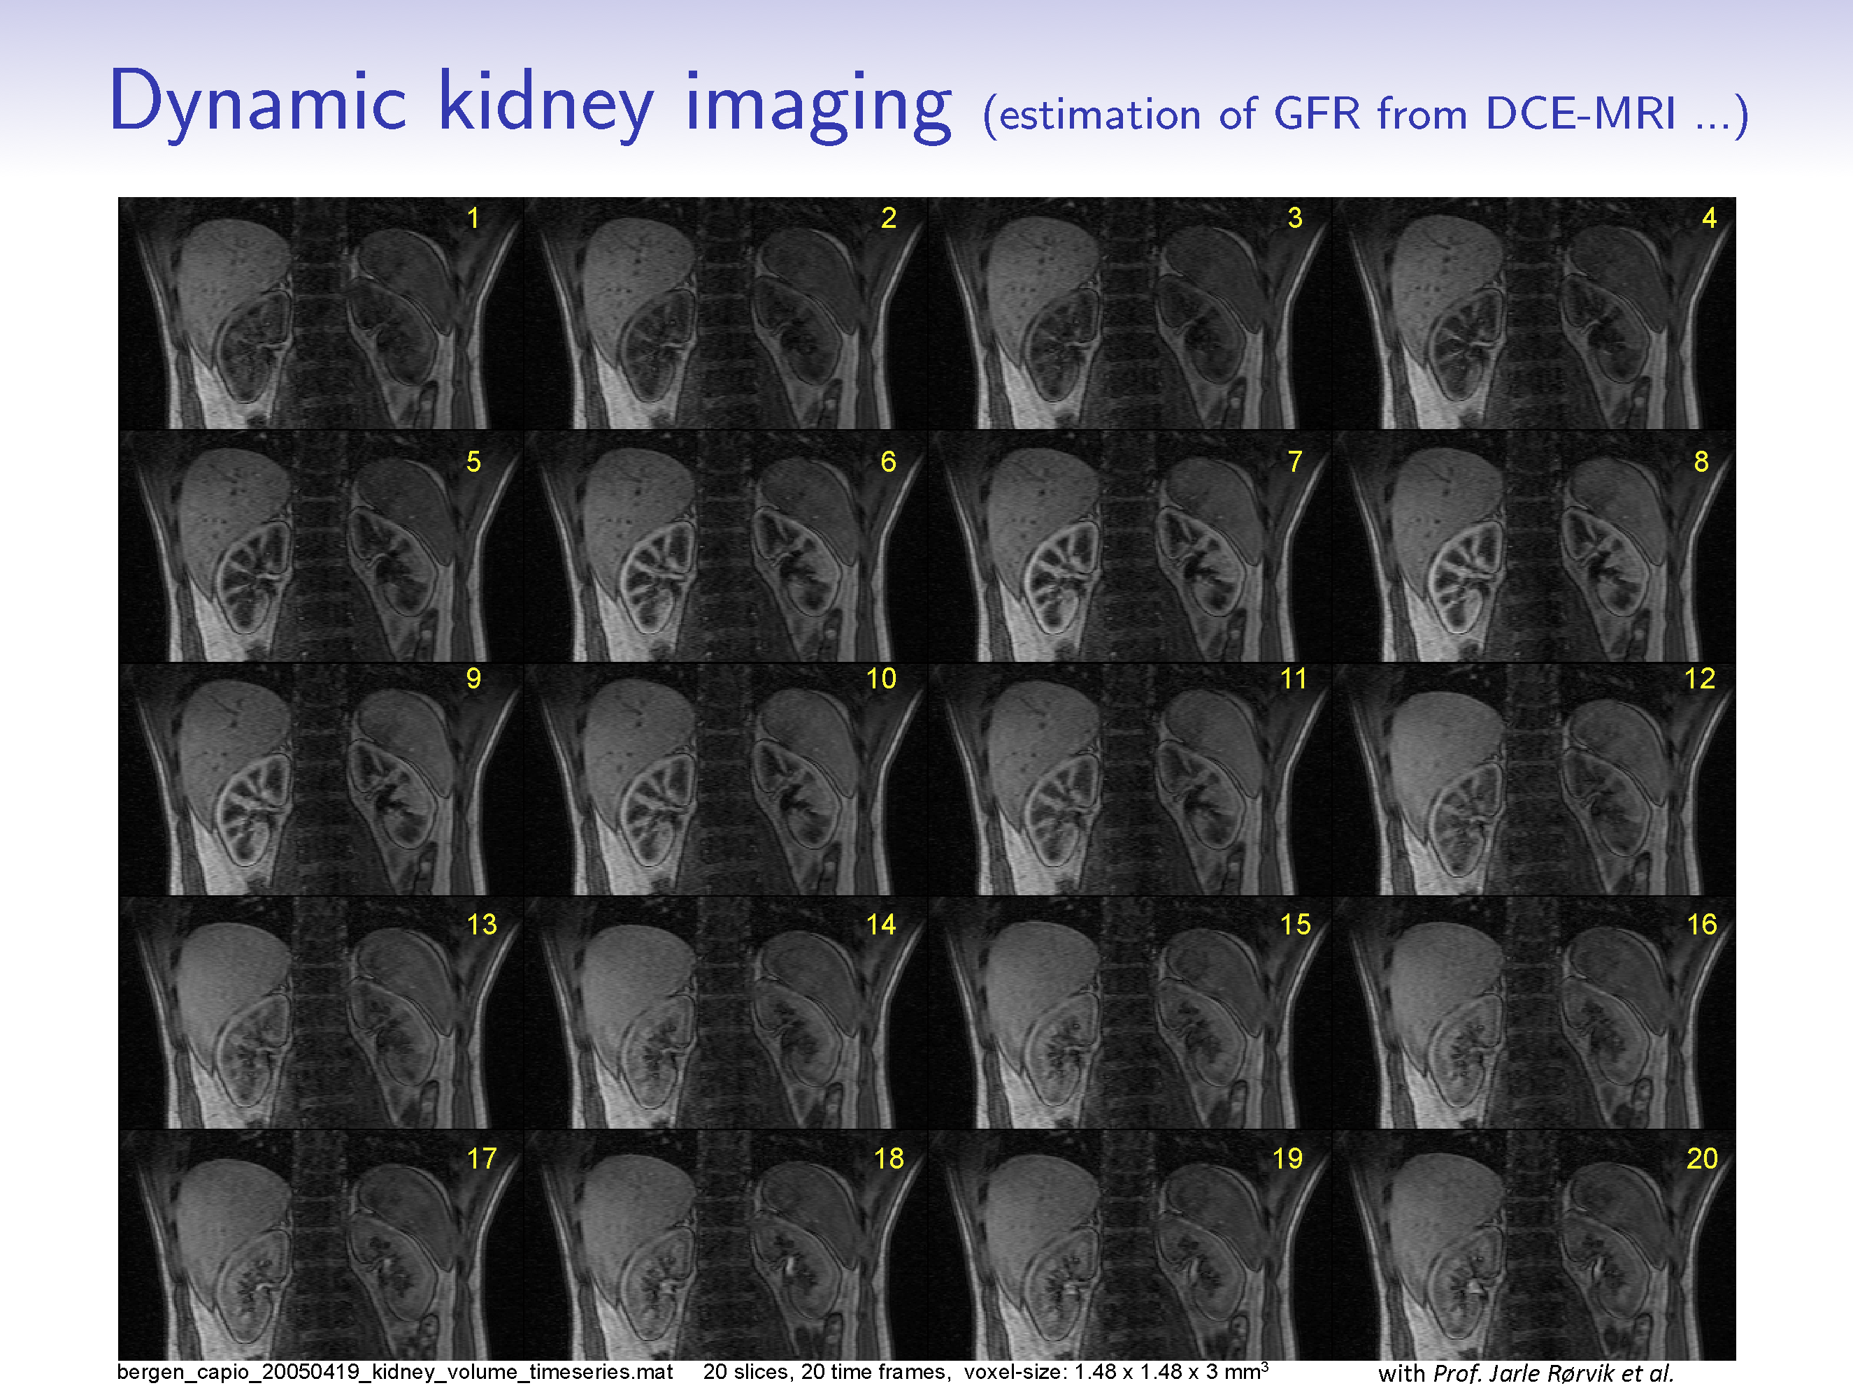
DCE-MRI of the moving kidney

Slide 17
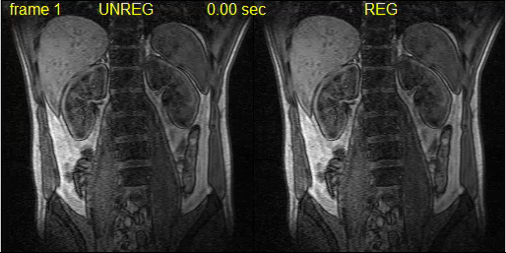
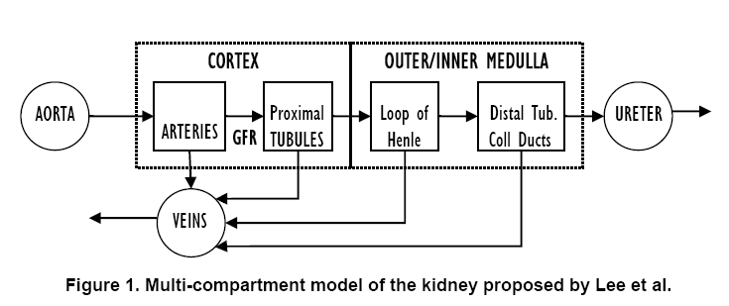
Pharmacokinetic modeling of perfusion and filtration using DCE-MRI
The
motion-
corrected
kidney
The
moving
kidney
R. Sance et al., ISPA 2006
Lee VS et al. Renal function measurements from MR renography and a simplified multicompartmental model. Am J Physiol Renal Physiol 2007;292:F1548–F1559.

Slide 18
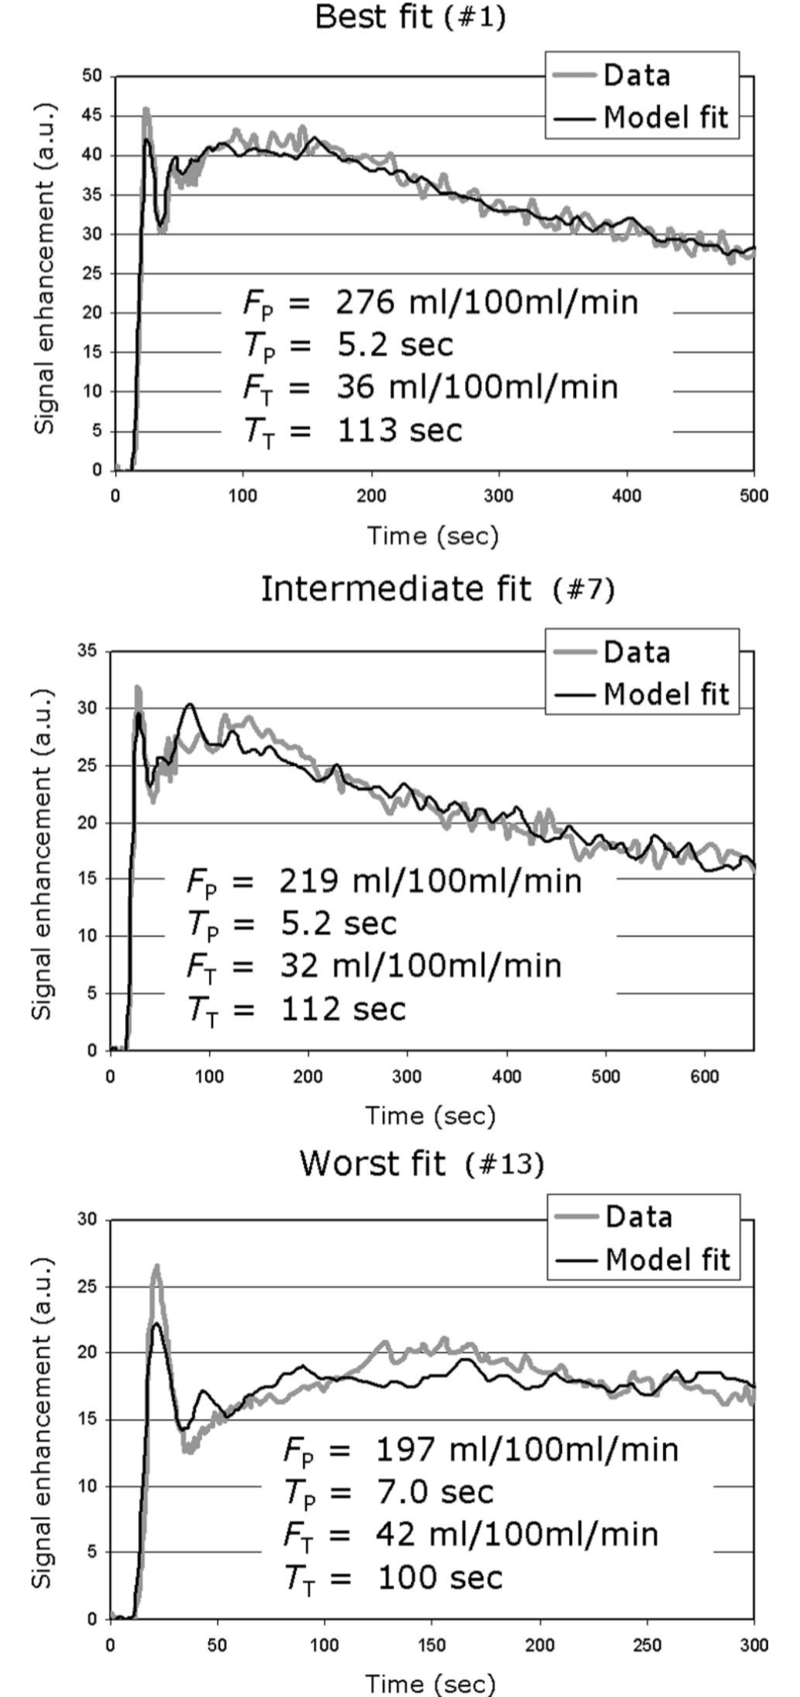
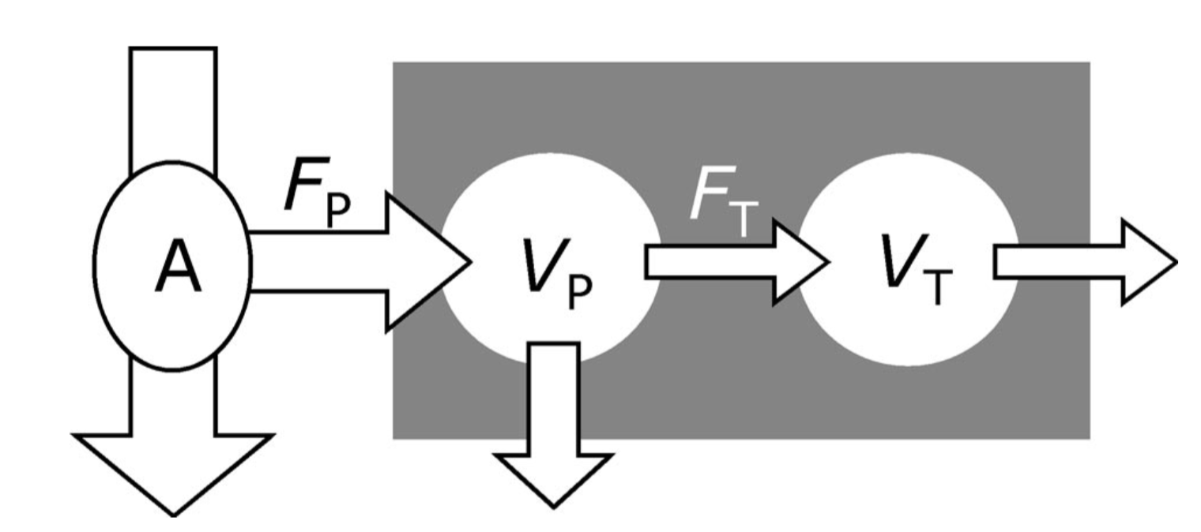
MRI-measurement of perfusion and glomerular filtration in
the human kidney with a separable compartment model
(Sourbron et al., 2008)
Feeding artery
Tissue voxel
Plasma
Tubuli
f (reabsorption fraction)
The plasma flow F_{P} carries the contrast agent from an
arterial region (A) into the tissue (gray rectangle)
It first enters the tissue plasma, where it distributes over
the plasma volume VP
A fraction of the entering contrast agent is filtered out of
the vascular space and is carried by the tubular flow F_{T} into
the tubular system where it distributes over the tubular volume VT
In the tubuli a fraction f of the filtrate is reabsorbed.
The contrast agent leaves the tissue carried by the outflow
out of the vascular and tubular spaces.
Sourbron et al. MRI-Measurement of Perfusion and Glomerular Filtration in the Human Kidney With a Separable Compartment Model. Investigative Radiology 2008;43:40-48.

Slide 19
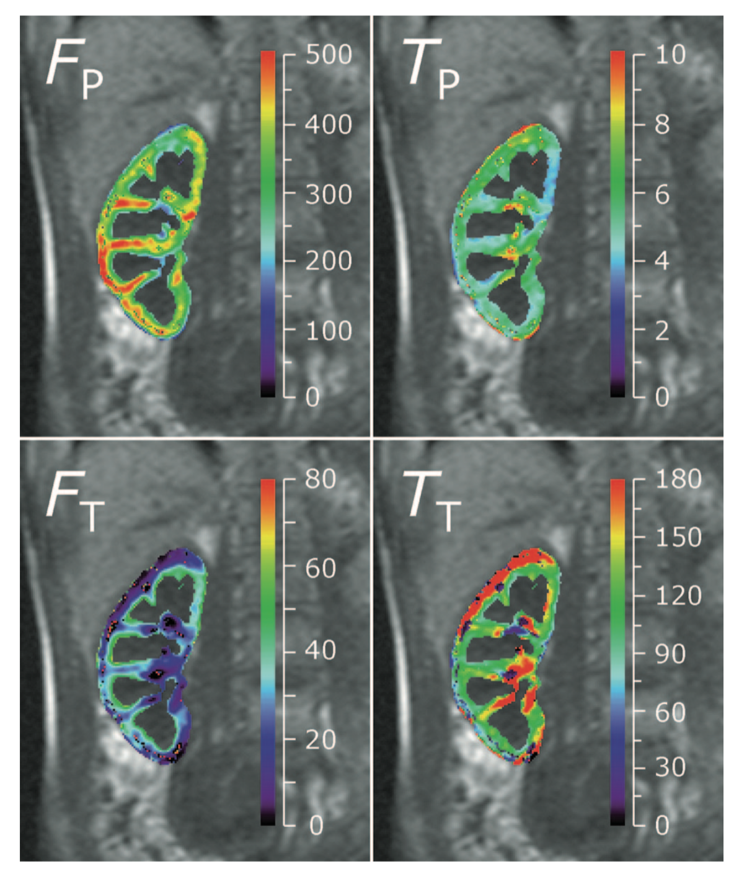
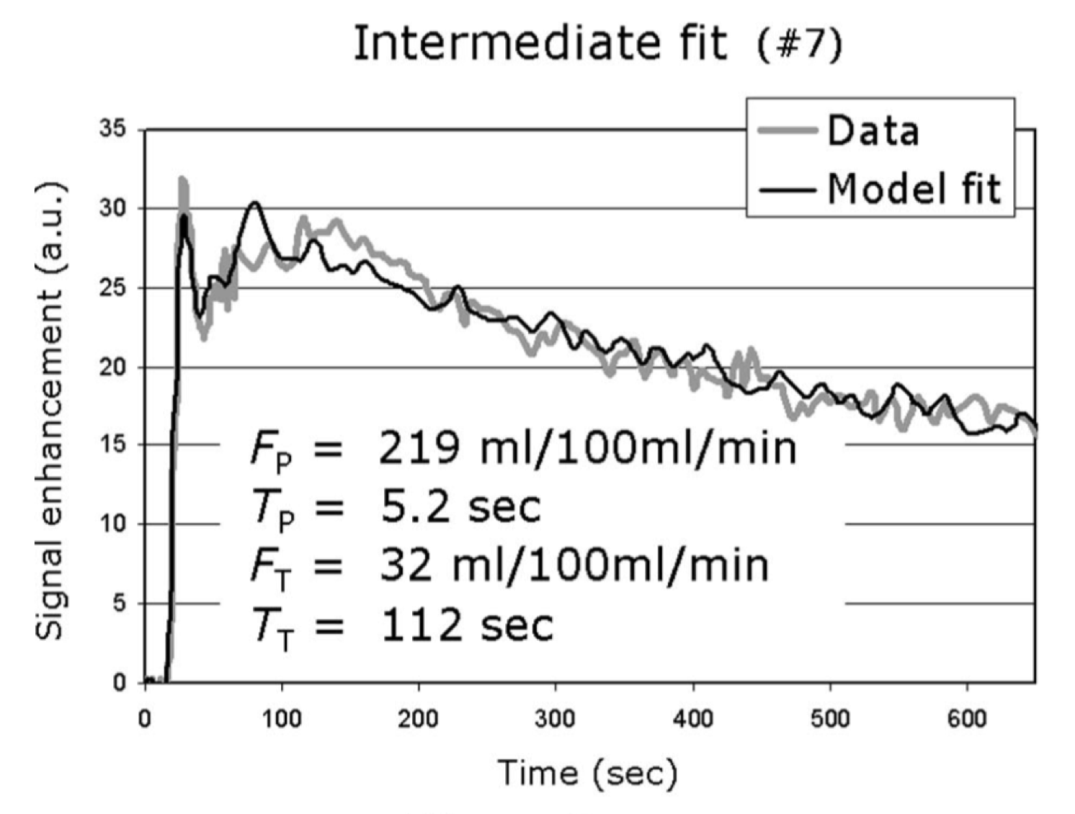
MRI-measurement of perfusion and glomerular filtration in
the human kidney with a separable compartment model
The four independent model parameters
F_{P} (mL/100 mL/Min)
T_{P} = MTT_{P} (sec)
F_{T} (mL/100 mL/ Min)
T_{T} = MTT_{T} (sec)
for the data with the intermediate fit accuracy
The cortex region was defined retrospectively as those pixels with V_{P} > 20 mL/100 mL.
The parametric maps (colored) are superposed on a precontrast image (gray) for anatomic reference.
Sourbron et al. MRI-Measurement of Perfusion and Glomerular Filtration in the Human Kidney With a Separable Compartment Model. Investigative Radiology 2008;43:40-48.

Slide 20
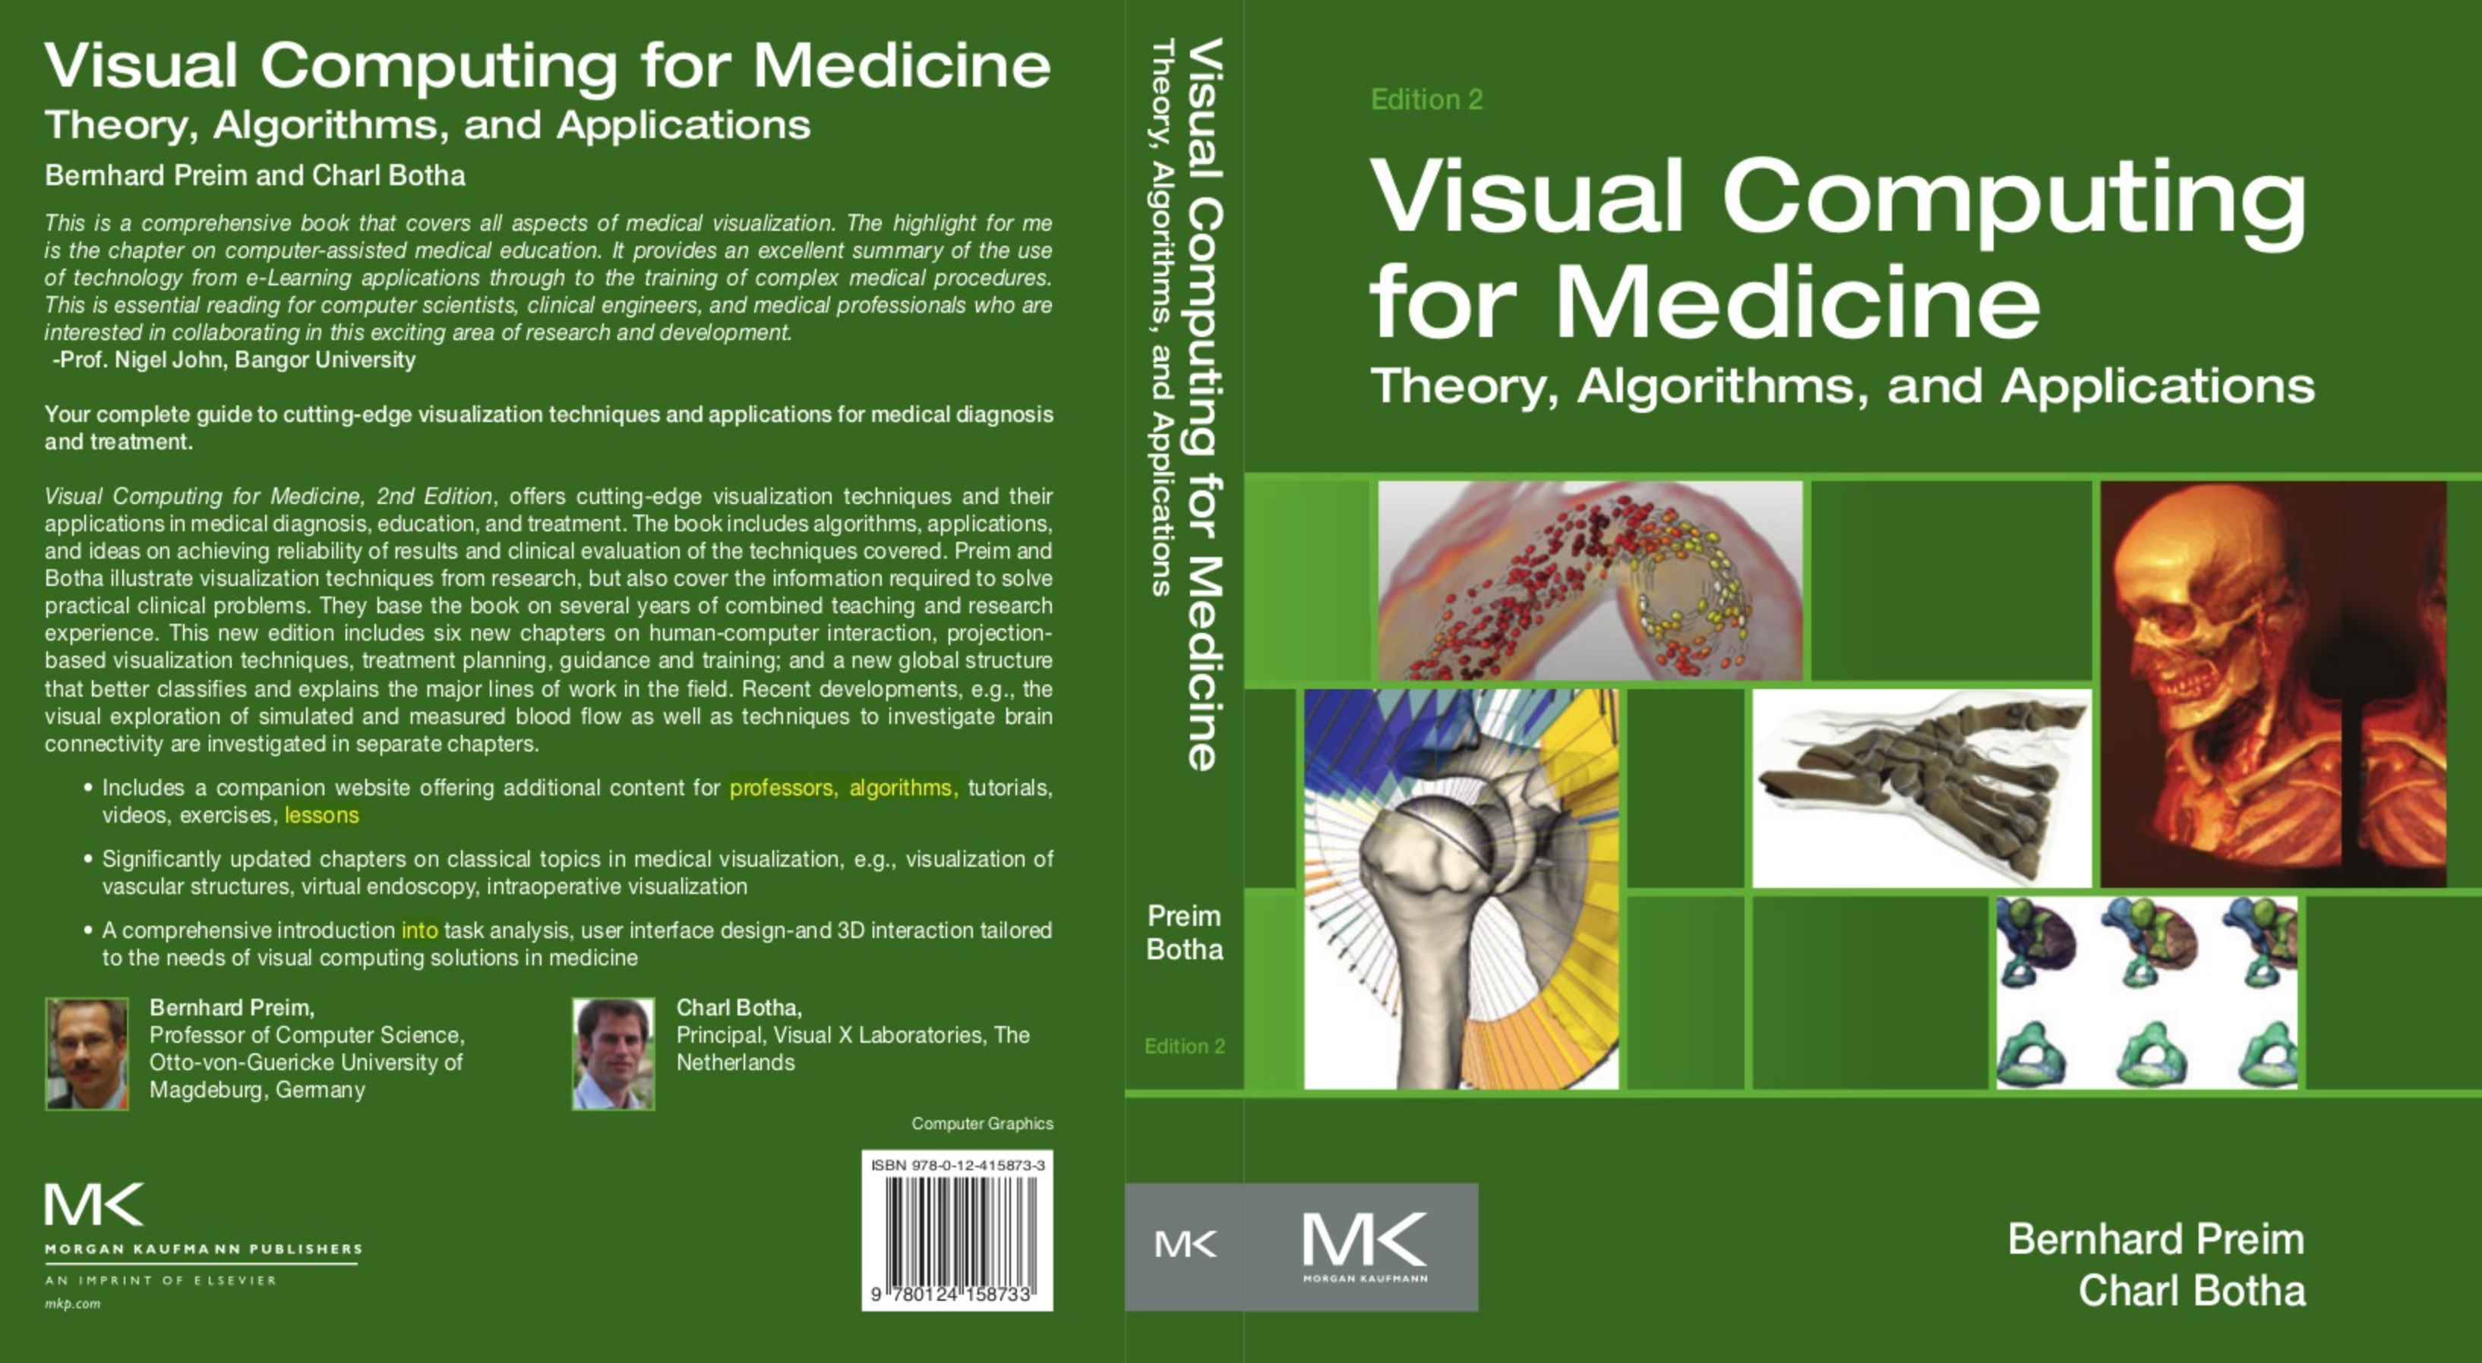
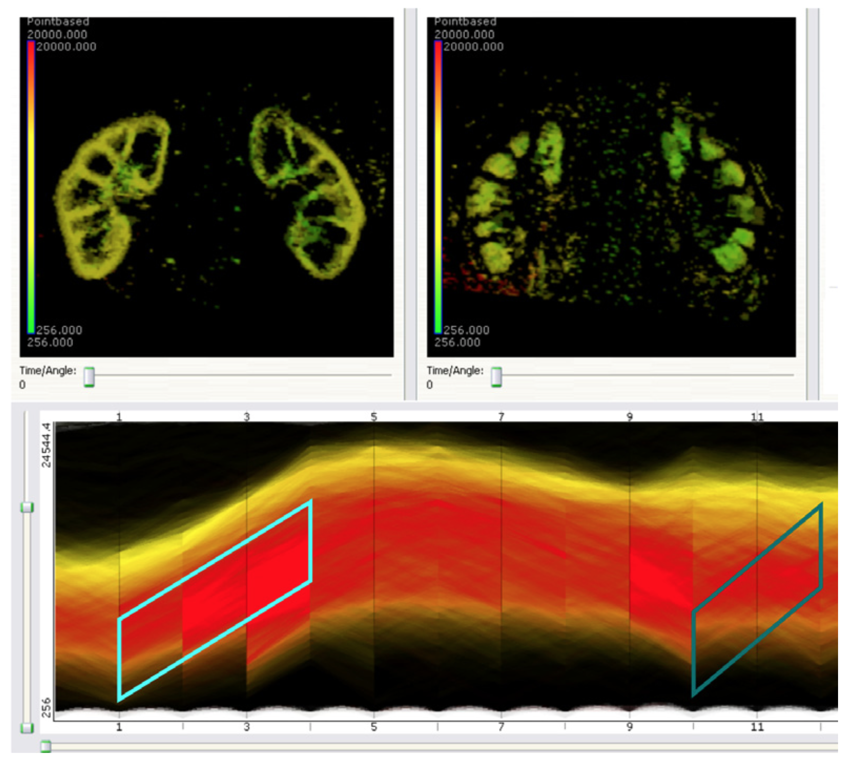
Visual Exploration and Analysis
of Perfusion Data
Preim B, Botha C. Visual Computing for Medicine, Second Edition.
http://dx.doi.org/10.1016/B978-0-12-415873-3.00016-X
The lower image depicts all time-intensity curves of a renal perfusion study.
Gradient sum brushes are employed to select regions with similar perfusion characteristics.
In the top left image, the renal cortex is shown based on the selection with left brush.
The right image shows the renal medulla where contrast enhancement occurs later.
(Courtesy of Steffen Oeltze, University of Magdeburg)

Slide 21
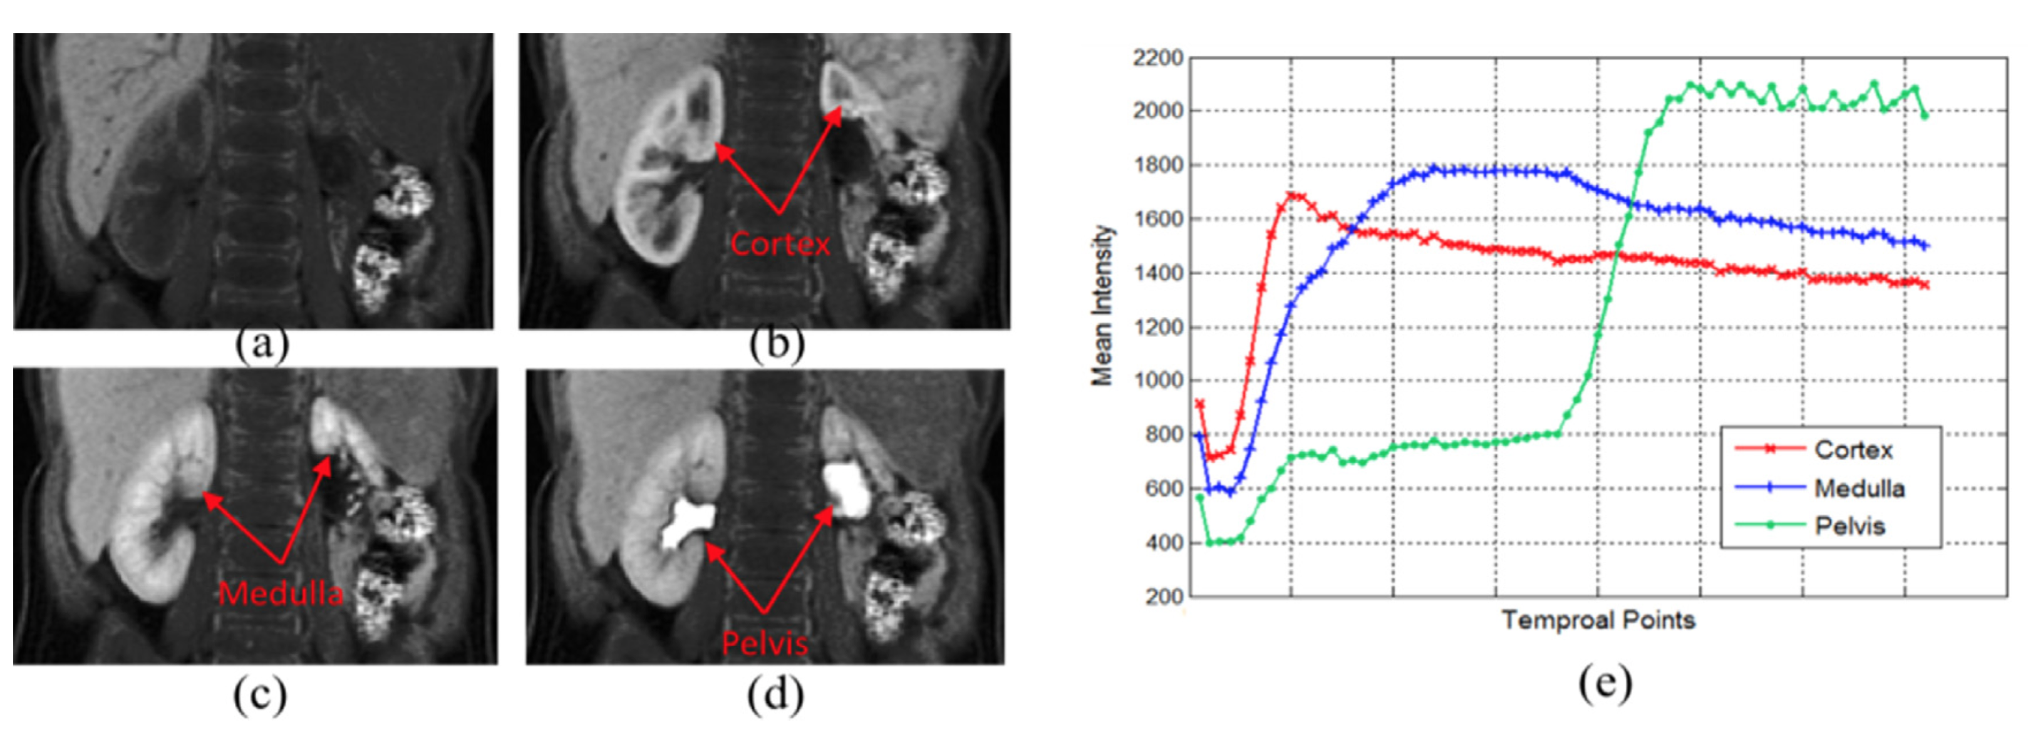
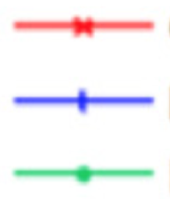
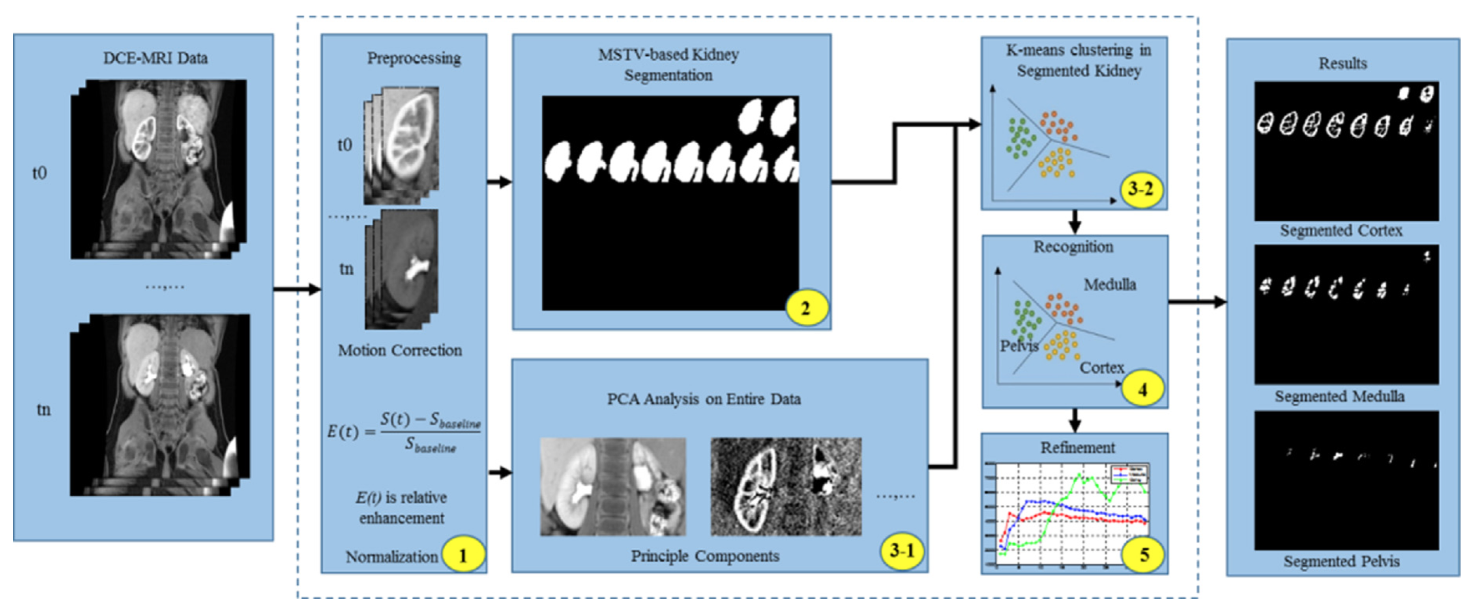

Renal compartment segmentation from DCE-MRI
(a) - (d) An exemplar slice of DCE-MRI series including both kidneys at four temporal points 1, 3, 7, and 23 respectively. For this patient, 1156 abdomen images are taken at 34 temporal points.
(e) By analyzing the enhancement of the renal tissues as a function of time, i.e. time intensity curves, one can determine clinically important single-kidney parameters such as the renal blood flow (RBF), glomerular filtration rate (GFR), and cortical and medullary blood volumes.
Mean signal intensity
Cortex
Medulla
Pelvis
Temporal measurements
DCE-MRI data
Preprocessing
MSTV-based Kidney
Segmentation
K-means clustering in segmented kidney
Results
t₀
t₀
Recognition
Segmented cortex
t_{n}
Medulla
Motion correction
Cortex
t_{n}
PCA Analysis on Entire Dataset
Segmented medulla
E(t) =
S(t) – S_{baseline}
S_{baseline}
Refinement
E(t) is relative
enhancement
Normalization
Principal Components
Segmented pelvis
MSTV = Maximally Stable Temporal Volume
Yang X et al. Renal compartment segmentation in DCE-MRI images. Medical Image Analysis 2016;32:269-280.

Slide 22
DCE-MRI: numerical analysis software
Interactive Data Language (IDL)
http://www.harrisgeospatial.com/ProductsandSolutions/GeospatialProducts/IDL.aspx
Sourbron S, Biffar A, Ingrisch M, Fierens Y, Luypaert R.
PMI: platform for research in medical imaging.
Magn Reson Mater Phy. 2009 Oct 1;22(1):539.
https://github.com/plaresmedima/PMI-0.4
PMI
https://sites.google.com/site/plaresmedima
OsiriX (C/C++) on MacOS
www.osirix-viewer.com
Zöllner FG, Daab M, Sourbron SP, Schad LR, Schoenberg SO, Weisser G.
An open source software for analysis of dynamic contrast enhanced magnetic resonance images: UMMPerfusion revisited.
BMC Med Imaging. 2016;16:7. doi:10.1186/s12880-016-0109-0.
http://ikrsrv1.medma.uni-heidelberg.de/redmine/projects/ummperfusion
UMMPerfusion
MATLAB
www.mathworks.com
Schmid VJ, Whitcher B, Padhani AR, Yang GZ.
Quantitative analysis of dynamic contrast-enhanced MR images based on Bayesian P-splines.
IEEE Trans Med Imaging. 2009;28(6):789-798. doi:10.1109/TMI.2008.2007326
https://github.com/petmri/ROCKETSHIP
ROCKETSHIP

Slide 23
DCE-MRI: numerical analysis software
The R language
www.r-project.org
Schmid VJ, Whitcher B, Padhani AR, Taylor NJ, Yang GZ.
Bayesian methods for pharmacokinetic models in
dynamic contrast-enhanced magnetic resonance imaging.
IEEE Transactions on Medical Imaging 2006;25(2):1627-1636.
http://dcemri.sourceforge.net https://cran.r-project.org/web/packages/dcemriS4
dcemriS4
The R language
Ferl GZ.
DATforDCEMRI: An R Package for Deconvolution Analysis
and Visualization of DCE-MRI Data
Journal of Statistical Software 2011;44(3):1-18.
https://cran.r-project.org/web/packages/DATforDCEMRI
www.r-project.org
DATforDCEMRI
The Julia language
http://julialang.org
Smith DS, Li X, Arlinghaus LR, Yankeelov TE, Welch EB.
DCEMRI.jl: a fast, validated, open source toolkit for dynamic
contrast enhanced MRI analysis.
PeerJ. 2015;3:e909. doi:10.7717/peerj.909
https://github.com/davidssmith/DCEMRI.jl https://www.ncbi.nlm.nih.gov/pubmed/25922795
DCEMRI.jl
The Python language
Python module :
https://github.com/welcheb/pydcemri
www.python.org

Slide 24

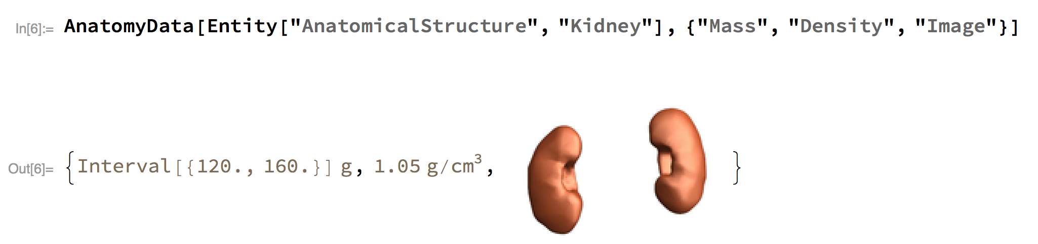
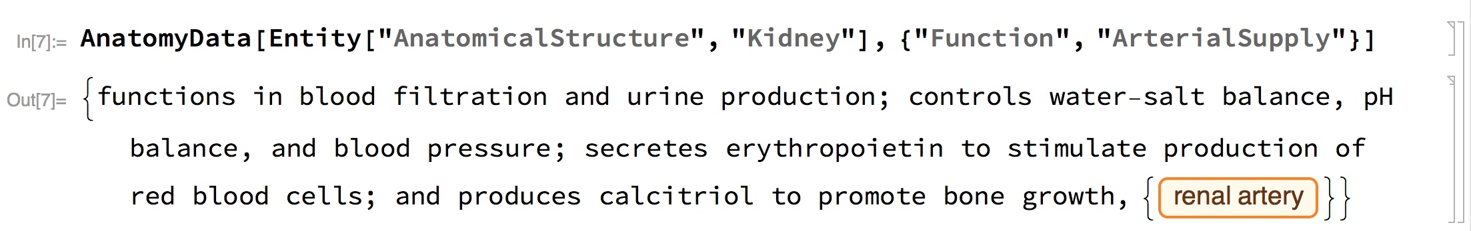


Software - the kidney & computational anatomy

Slide 25





Mass of
injected substance
Rate transfer coefficients
DIDACTIC
d(t)
Absorption
coefficient
k₁₂
c₁(t)
c₂(t)
k_{a}
Software
Pharmacokinetic modeling
k₂₁
k_{el,1}
k_{el,2}
Elimination rates
ro = 1
http://demonstrations.wolfram.com/PharmacokineticModeling

Slide 26



DIDACTIC
http://demonstrations.wolfram.com/PharmacokineticModeling
Software - Pharmacokinetic Modeling
In DCE-MRI
we are
solving the
inverse
problem:
Estimate the
parameters
(e.g. GFR, RPF)
by fitting
the measured
data to
the model
(in the least
squares sense,
using an
optimization
scheme)

Slide 27


Summary
(Grenier et al., 2016)
AIF
Tissue
a) The renogram is a map of the maximal signal intensity that can be obtained after injection of a gadolinium-based tracer bolus.
c) A two-compartment model is applied to these kinetic data to extract the perfusion component and the extraction component.
d) Quantitative maps of perfusion and glomerular filtration rate (GFR; in ml/min/g of tissue) can be generated from these data, respectively.
b) By placing a region of interest on the aorta (red) and on the cortex (yellow), signal intensity time curves (kinetic curves) can be produced.
The aortic kinetic curve enables characterization of the shape of the bolus (arterial input function, AIF).
Grenier et al. Radiologic imaging of the renal parenchyma structure and function. Nature Reviews Nephrology 2016;12:348–359

Slide 28
Summary
Kidney structure and function – the core parameters: RPF and GFR
“Mass balance” - compartment models and tracer kinetic principles
DCE-MRI - the most established measuring technique for renal perfusion and filtration (but also: Arterial Spin Labeling, ASL - non-contrast perfusion imaging, and BOLD fMRI)
Parameter estimation (GFR and RPF) - possible down to single voxels
The importance of motion correction and kidney segmentation
The value of model-free visual exploration and analysis
Software for model-based estimation of renal perfusion and filtration
in the context of “open science” & “reproducible research”
Not covered: (see Syllabus @ https://github.com/arvidl/functional-kidney-imaging)
Mapping: SI time courses → [Gd] time courses (MR sequence dependent)
AIF and deconvolution
Validation (e.g. MR-GFR vs. iohexol-GFR w/blood sampling) and test-retest reliability
e.g. Eikefjord et al. AJR 2015, 2106

Slide 29
Thanks !

